Slide 1

The Meta Moment
Summer 2023

Slide 2

Intended Outcomes
By end of this session,
You will gain an understanding of:
  The phases of the Meta-Moment Tool
  The value of activating your “best self”
  How to develop its use into a habit
You will be better equipped to:
  Contribute to an environment that will help students and those around you….

Slide 3


Let’s Review: The RULER Skills
Recognizing emotions in ourselves and others
Understanding the causes and consequences of emotions
Labeling emotions accurately
Expressing emotions appropriately
Regulating emotions effectively

Slide 4




THE RULER ANCHOR TOOLS
The Charter represents agreed-upon norms for how everyone in a school, classroom, or other environment wants to feel. The Charter also explains what needs to happen or change to build and sustain positive emotional climates.
The Mood Meter is a visual guide to help individuals accurately analyze and “plot” their feelings. The Mood Meter develops skills in recognizing and labeling emotions, which can be further developed into understanding, expressing, and regulating emotions.
The Meta-Moment is a process for responding to emotional triggers in ways that align with one’s best self. The goal is to shift from automatic, unhelpful reactions to strategic, effective responses.
The Blueprint is a problem-solving tool for working with interpersonal conflicts. The Blueprint can be used independently or collaboratively to enhance empathy and identify effective solutions for past, real-time, or anticipated conflicts.

Slide 5
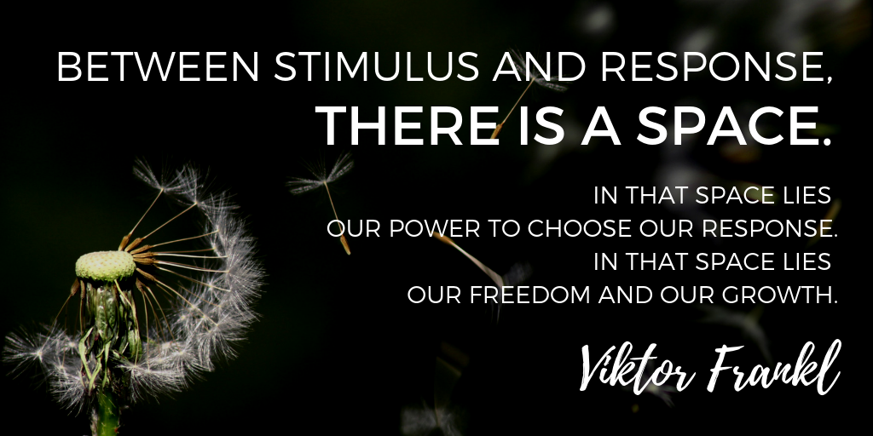
META-MOMENT

Slide 6







META-MOMENT
The Meta-Moment consists of four steps:
  Sense that something has happened or changed in your environment
  Pause to de-escalate and avoid responding in an unhelpful manner
  See your best self, or visualize a positive image of yourself
  Strategize and act in a more helpful manner
Notes:
The Meta-Moment teaches both children and adults to prolong the space between that trigger that we all have and our reaction or our healthy response. And it's a process during an interaction that helps people first recognize a shift that just occurred. You are activated with a strong emotion, caught off guard, or have an impulse to say or do something you might regret. You feel a shift in your thinking or body or both.
The second piece of the Meta-Moment says let's pause. Let's not react; let's take that breath; let's build that space.
The third part of the Meta-Moment is called your best self. Think of adjectives or an image that helps your best self appear in vivid detail, or look at an object that reminds you. You might also think about your reputation: How do you want to be seen, talked about, and experienced? What would you do if someone you respect were watching you? And what they have found in their research is that when you can teach children and adults to think about their best self - meaning I am a teacher who is caring and compassionate; I am a parent who is loving and kind - that activation of your best self helps you to choose more effective strategies…
…to then move to step 4, which is the regulation of emotion or strategizing. That instead of using negative self-talk, you use positive self-talk. Instead of blaming you'll start reframing. Instead of yelling and screaming, you'll do problem solving.
The goal is that successful interaction in that process. So it's this process to really help people manage emotions more effectively and build relationships as opposed to destroy them.

Slide 7

META MOMENT STORY
https://youtu.be/yKXLEJqxUxw?t=7

Slide 8

OPPORTUNITY FOR REFLECTION
Think of a situation with someone else where you would have appreciated if they would have used a meta-moment during their interaction with you.
Think of an interaction in the past that would have had a more productive outcome if you had taken a meta-moment for yourself.
What are examples of barriers to taking a meta-moment?

Slide 9
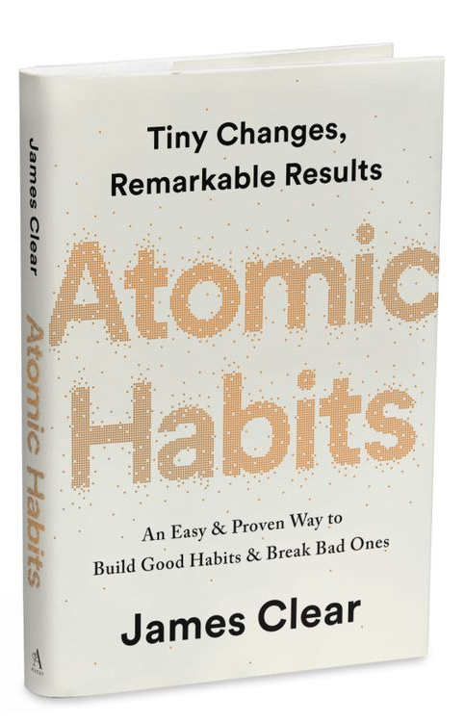
MAKING IT A HABIT
Habits are the compound interest of self-improvement. Getting 1% better every day counts for a lot in the long-​run.
Habits are a double-​edged sword. They can work for you or against you, which is why understanding the details is essential.
Small changes often appear to make no difference until you cross a critical threshold. The most powerful outcomes of any compounding process are delayed. You need to be patient.
If you want better results, then forget about setting goals. Focus on your system instead.
It’s not about what you want to do as much as who you want to be!

Slide 10



GOALS ARE OVER-RATED
Problem #1: Winners and losers have the same goals.
Problem #2: Achieving a goal is only a momentary change.
Problem #3: Goals restrict your happiness.
Problem #4: Goals are at odds with long-term progress.
You don’t rise to the level of your goals.
You fall to the level of your systems.
Notes:
Successful and unsuccessful people may share the same goals, so the goal can’t be what differentiates the winners from the losers. It’s only when they implement a system of continuous small improvements that they achieved a different outcome.
Achieving a goal only changes your life for a moment. That’s the counterintuitive thing about improvement: we think we need to change our results, but the results are not the problem. What we really need to change are the systems that cause those results.
The implicit assumption behind any goal is “Once I reach my goal, then I’ll be happy.” The problem with a goal-first mentality is that you’re continually putting happiness off until the next milestone. But even then, how long does the celebration last until you’re on to the next thing?
Yo-yo effect (i.e. training for a race). When all of your hard work is focused on a particular goal, what is left to push you forward after you achieve it? The purpose of building systems and habits is to continue playing the game. Ultimately, it’s your commitment to the process that will determine your progress.

Slide 11

LAWS OF BEHAVIOR CHANGE
Identity Model
Improvements are only temporary until they become part of who you are
In the beginning, it is far more important
to focus on a desired identity than a
particular result
Every action you take is a vote for the
type of person you wish to become.

Slide 12

CRITICAL THRESHOLD OF CHANGE
Notes:
Imagine that you have an ice cube sitting on the table in front of you.
The room is cold and you can see your breath. It is currently twenty-​five
degrees. Ever so slowly, the room begins to heat up.
Twenty-six degrees…Twenty-seven…Twenty-eight…The ice cube is still sitting on the table in front of you…Twenty-nine degrees…Thirty…Thirty-one.
Still, nothing has happened.
Then, thirty-​two degrees. The ice begins to melt. A one-​degree shift, seemingly no different from the temperature increases before it, has unlocked a huge change.
Breakthrough moments are often the result of many previous actions, which build up the potential required to unleash a major change.

Slide 13

CRITICAL THRESHOLD OF CHANGE
Breakthrough moments are often the result of many previous actions, which build up the potential required to unleash a major change.
Notes:
Imagine that you have an ice cube sitting on the table in front of you.
The room is cold and you can see your breath. It is currently twenty-​five
degrees. Ever so slowly, the room begins to heat up.
Twenty-six degrees…Twenty-seven…Twenty-eight…The ice cube is still sitting on the table in front of you…Twenty-nine degrees…Thirty…Thirty-one.
Still, nothing has happened.
Then, thirty-​two degrees. The ice begins to melt. A one-​degree shift, seemingly no different from the temperature increases before it, has unlocked a huge change.
Breakthrough moments are often the result of many previous actions, which build up the potential required to unleash a major change.

Slide 14

META MOMENT STORY
https://youtu.be/L12b5JoRT6I

Slide 15

IT ALL BEGINS AND ENDS
IN YOUR MIND.
WHAT YOU GIVE POWER TO
HAS POWER OVER YOU...
IF YOU ALLOW IT.
LEON BROWN
Notes:
The following sayings emphasize that we can decide what has power over us, and we can decide who we listen to.

Slide 16

IT AIN’T WHAT THEY CALL YOU.
IT’S WHAT YOU ANSWER TO.
W.C. FIELDS

Slide 17

MY MOTTO IS:
I’M ALIVE,
SO THAT MEANS
I CAN DO ANYTHING.
VENUS WILLIAMS
Notes:
Now, let’s take a few minutes for you to create your own sayings or mantras. The point of this lesson is to avoid reacting in an unhelpful way. Ignoring insults, walking away from gossip, being the bigger person doesn’t make you weak; it makes you stronger.
After creating your own mantras, feel free to share your mantra if you feel comfortable.

Slide 18

Resource Depletion
Resource depletion refers to the limited amount of mental resources we have on any given day.
For example, we may have a limited amount of brainpower to focus, a limited amount of energy before we need to sleep, etc.

Slide 19

When we’re tired, hungry, stressed, or sick after a long day, our resources are at lower levels. This is when we’re more likely to be triggered.
Depleted resources put us at risk for reacting to triggers without thinking about the consequences first.
Are you more likely to be triggered at certain times of the day or in certain situations?

Slide 20
Step 2: Pausing
When we’re triggered and our resources are depleted, it’s helpful to consider emotion regulation strategies for pausing (Step 2 of the Meta-Moment).
Before reviewing the strategies on the following slides, take a moment to discuss what strategies you already use.

Slide 21

Taking Space
The first strategy is to take space.
This means putting physical distance between yourself and the trigger before you make any other decisions.
Have you ever used a strategy like this? When do you think it’s most useful?

Slide 22

Snap Out of It!
The second strategy is to “snap out of it” when you feel you are spiraling out of control emotionally. It’s about creating a sensation you can’t ignore to bring you back to the present moment.
To do this, you might pinch yourself, snap a rubber band on your wrist, eat a lemon, hold a piece of ice, or blast music.

Slide 23

Count On It
The next strategy is counting. To practice, try counting back from 100 by 13’s. It’s hard – try it as a group!
The point of this strategy is that you have something to focus on besides your emotions for a moment, which delays you from making a poor choice.

Slide 24
Be Mindful
The fourth strategy is to take a moment to be mindful. Let’s try it!
Think of four things you can currently see. When you’ve thought of four, raise your hand – then wait for all hands to be raised.
Now, close your eyes or lower your gaze. Think of three things you can feel right now and raise your hand when you have them.
Now, try to name two things you can hear, and raise your hands.
Lastly, name one thing you can taste or smell right now.
When might this strategy be helpful for pausing?

Slide 25

Keep Breathing
The final strategy is breathing.
Breathing is the only bodily process that is usually automatic, but we can take it over consciously when we choose to.
If we pay attention, we can make ourselves breath faster or slower, deeper or more shallowly.

Slide 26
When we take control of our breathing, this changes what part of the brain controls our breathing.
The brain stem controls automatic breathing.
However, when we decide to control our breathing, the motor cortex takes control. This part of the brain also allows us to move a body part, shoot a basketball, or dance.
Breathing

Slide 27
Breathing
You’ve probably been told to take deep breaths to calm down.
Why is that?
Taking slow, deliberate breaths, can improve our immune systems, and help with symptoms of asthma, mental health problems, or high blood pressure.

Slide 28

Remember
When we feel triggered, it’s important to keep emotion regulation strategies for pausing in mind.
Breathing decreases the negative impact that stress can have on our bodies.

Slide 29
META-MOMENT
Using Meta-Moments in a responsive way takes repeated practice, which is why it’s helpful to try them out on lower stress situations first (taking a Meta-Moment when sitting in traffic) versus higher stress ones (a student pushes your hot button in front of the whole class).
Personal Reflection Activity:
What are some steps you will take to create a habit of taking meta moments?

Slide 30
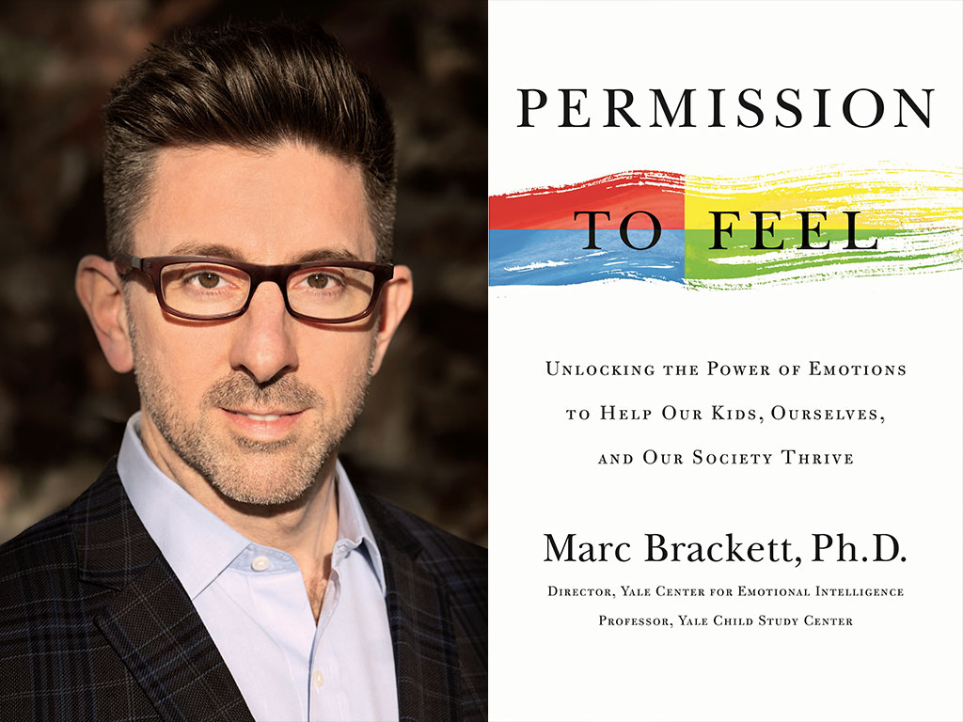
CLOSING THOUGHTS
That calmed me down in a hurry. I think Mike Tyson had it right when he said, “Everybody has a plan until they get punched in the mouth.” What’s true in the boxing ring is true everywhere else. It’s easy to say that from now on we’ll master all our emotional responses, until our significant other or cranky child or unreasonable boss triggers us with a word or look and - suddenly - all our RULER training goes out the window.

Slide 31

CLOSING THOUGHTS
Marc Brackett (from Permission to Feel)
I think Mike Tyson had it right when he said, “Everybody has a plan until they get punched in the mouth.”
What’s true in the boxing ring is true everywhere else.
It’s easy to say that from now on we’ll master all our emotional responses, until our significant other or cranky child or unreasonable boss triggers us with a word or look, and - suddenly - all the RULER training goes out the window.

Slide 32
CLOSING THOUGHTS
So, along with permission to feel, we must also
give ourselves permission to fail.
When that happens, we can only try again — take a deep breath or two, envision our best selves, and start over at the first “R” (of RULER).
At such moments, we also need the courage to apologize and forgive ourselves as we’d forgive others. Courage can even mean seeking professional help when all else fails.
We’ll never stop having to work at being our best selves. But the payoff is worth it: better health, better decision making, better relationships …better everything.

Slide 33

ARE YOU FEELING IT?
...Thank you!

