Slide 1


Digital Life 102
Common Sense Media

Slide 2
Digital Media…
Give an example of digital media.
How is it used?
What does it allow you to do?
Notes:
Ask students their interpretation of the term digital media.
digital media:
electronic devices and media platforms such as computers, cell phones, video, the Internet, and video games that allow users to create, communicate, and interact with one another or with the device or application itself .

Slide 3



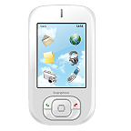
Digital Media Defined…
Electronic devices and media platforms such as computers, cell phones, video, the Internet, and video games that allow users to create, communicate, and interact with one another or with the device or application itself .

Slide 4


Got Media Smarts?
You will need a pen/pencil & quiz.
Some questions are difficult so make your best estimate/guess.
We will correct together to see how you did!
Notes:
You can have students take this as partners or individually.
Instead of having them trade to correct, give them a few minutes to complete (15?) and then project the answers and look at teacher notes in the following slides to lead the discussion.

Slide 5

Quiz Results
Correct your own or trade with a partner.
Q: | Answer | Q: | Answer
1 | D | 8 | D
2 | D | 9 | C
3 | D | 10 | D
4 | C | 11 | D
5 | D | 12 | D
6 | A | 13 | D
7 | D | 14 | A
Which one or two answers surprised you the most?
Which one or two statistics most closely reflect how you use digital media in your own life?
Which are the farthest from your own personal experience?
Notes:
ASK:
Which one or two answers surprised you the most?
ASK:
Which one or two statistics most closely reflect how you use digital media in your own life? Which are the
farthest from your own personal experience?
Students should recognize that the same kinds of principles apply in both places, but they play out in different ways.
Answer Key
1.
D
2.
D
3.
D
4.
C
5.
D
6.
A
7.
D
8.
D
9.
C
10.
D
11.
D
12.
D
13.
D
14.
A

Slide 6

Digital Life Similes
What is a simile?
Your turn!
  Create a simile to express the role digital media plays in your life.
Notes:
simile:
a figure of speech in which a comparison is made to show a similarity between two different things. A simile resembles a metaphor, but in a simile the word like or as is used to make the comparison

Slide 7
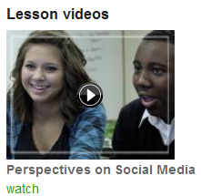
Life in a Connected Culture
Show Video: Perspectives in Social Media
Click link to Video: http://www.commonsensemedia.org/educators/lesson/digital-life-102-9-12
Scroll down & click watch
Notes:
Show video through the link, then lead the class discussion using the following slides.

Slide 8

Discussion
What are some of the upsides and downsides of digital life according to the teens in the film?
What do you think the upsides and downsides are in your own lives?
Upsides | Downsides

Slide 9
Discussion
What are some of the upsides and downsides of digital media for relationships?
Upsides | Downsides

Slide 10
Discussion
What are some of the benefits of digital media for our country as a whole?
What are some of the problems it might cause?
Upsides | Downsides

Slide 11
Wrap up:
How did the statistics you learned in the quiz compare with the way you use digital media in your own life?
Which digital media in media do you think you use the most and the least – and why?
Notes:
Discuss with your students or have them write a response in an online format like Google Docs or www.surveymonkey.com.
Also look in the lesson in the Extension Activity using www.animoto.com

Slide 12
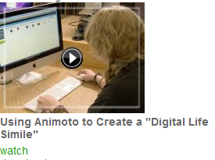
Wrap up:
What did your simile indicate about the role that digital media plays in your life?
Show Video: Using Animoto to Create a “Digital Life Simile”
Click link to Video: http://www.commonsensemedia.org/educators/lesson/digital-life-102-9-12
Scroll down & click watch
Notes:
Discuss with your students or have them write a response in an online format like Google Docs or www.surveymonkey.com.
Also look in the lesson in the Extension Activity using www.animoto.com

Slide 13
Wrap up:
Can you describe one upside and one downside for yourself about living in a digital world?
For your relationships with others?
For society as a whole?
Do you connect with others or create things with digital media?
Notes:
Discuss with your students or have them write a response in an online format like Google Docs or www.surveymonkey.com.
Also look in the lesson in the Extension Activity using www.animoto.com

