Slide 1

PREPARING FOR YOUR CAREER
APPLYING FOR A JOB
Cover Letter
Copyright © 2009, Thinking Media, a division of SAI Interactive, Inc. All rights reserved. The Career Ready 101 logo is a registered trademark and Career Ready 101 is a trademark of SAI Interactive, Inc.

Slide 2

Application Supporting Documents
The most common supporting documents are:
  Cover Letter
  Professional References List
  Follow-up Letter
  Thank you Letter
Spending extra time on these supporting documents helps you stand out from the crowd & shows the employer you are enthusiastic about the opportunity.

Slide 3

Cover Letter
A typical hiring manager does not read cover letter before the application.
They generally spend 10 to 15 seconds scanning your application.
If they like what they see, they will read more.

Slide 4
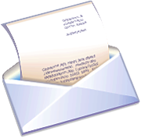
Cover Letter
A cover letter should…
  focus on company’s needs and how you meet their needs.
  reflect your understanding of the company & its needs.
  point out how your knowledge and skills fill those needs.

Slide 5

Cover Letter Tips
Biggest mistake:
  mass producing your resume & cover letter
  sending resume & cover letter to hundreds of
  employers.
Employers receive numerous resumes & applications daily.
They do not have time to thoroughly read every
application or resume.

Slide 6

Cover Letter Tips
Your cover letter should be specific and personal.
Research & identify the hiring manager.
Typically found on their website in the ‘About Us’ section.
You can also call the company’s Human Resources department.
Make sure it their name & title are spelled correctly.
Use their title, address, email address & telephone number on the letter.
This allows you to send the letter directly to them.

Slide 7
Cover Letter Tips
Keep cover letter to one page with three key paragraphs:
  Introduction (Why you are writing),
  Your Benefits (What you can do for the company)
  Closing (Next step).
Focus tone of letter on what you can do for the company.
What skills and experience you can bring to the company & how they would benefit from hiring you.

Slide 8

Email Cover Letter
If you submit application, resume & cover letter electronically, submit each individual document as an attachment.
Do not write cover letter in the email message.
Usually a HR support person is responsible for processing applications before forwarding them to the hiring manager.
The hiring manager might not see cover letter if it is in initial email message.

Slide 9
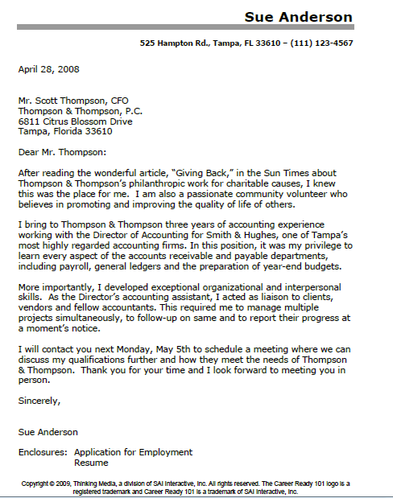
Example

Slide 10
Cover Letter Format
Cover letter should be typed using a standard business letter format.
Cover Letter Format:
Return Address – Design cover letter to look like Personal Contact Information section of resume.
  This will make cover letter look like a piece of customized stationery.
  It also brands all of your documents and looks professional.

Slide 11
Cover Letter Format
Date – Do not forget to put current date on all correspondence to an employer.
Inside Address – Include hiring manager’s name, title, company name & full mailing address.
Salutation – Cover letter should be personalized to hiring manager (Dear Mr. Thompson).

Slide 12
Cover Letter Format
The body of a cover letter should include these elements:
Introduction Paragraph – The first paragraph of cover letter should tell employer why you are writing.
  Try to be creative to peak the employer’s interest to want to continue reading your letter.
  Do not just state, “I am applying for the position you had on your website.”
  Instead, write what led you to research the company & what makes them different.

Slide 13
Cover Letter Format
Qualification Paragraph - Answer these questions in this paragraph:
  What can you do for the company?
  How do you benefit them?
It is your opportunity to sell yourself!
  Briefly state 3 to 4 related skills & qualifications for the position & highlight how they can benefit by hiring you.

Slide 14
Cover Letter Format
Conclusion Paragraph – In this paragraph, state your next step to move the process forward.
  Do not sit by phone & expect employer to call you.
  Tell the employer when you will follow up & how.
  For example, “I will contact you next week to schedule an in-person meeting or see if you have any questions or need additional information.”
Always follow through on what you say you will do!

Slide 15
Cover Letter Format
Closing - Always end the correspondence with ‘Sincerely’ as the closing; anything else would be unprofessional.
  If you print Cover Letter, remember to sign it.
  You do not need a signature on an electronic cover letter attached to an email.

