Slide 1

Eisenhower Middle School (Everett
School District)
Highlights from the Healthy Youth Survey
(March 1, 2017)

Slide 2
Student Participation
Eisenhower Middle School (Everett
School District)
  278 (90%) of Grade 6 students
  228 (83%) of Grade 8 students

Slide 3
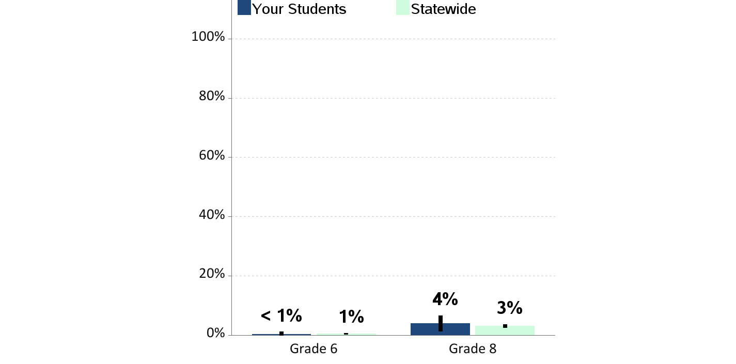
Current Cigarette Smoking
Percent of students who report smoking cigarettes
in the past 30 days

Slide 4
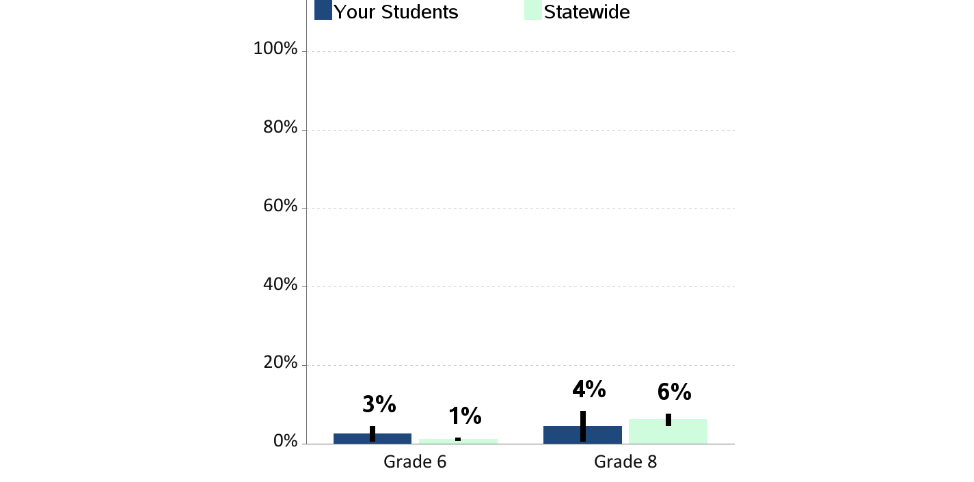
Current E-Cigarette Smoking or Vaping
Percent of students who report using an electronic cigarette,
e-cig or vape pen in the past 30 days

Slide 5
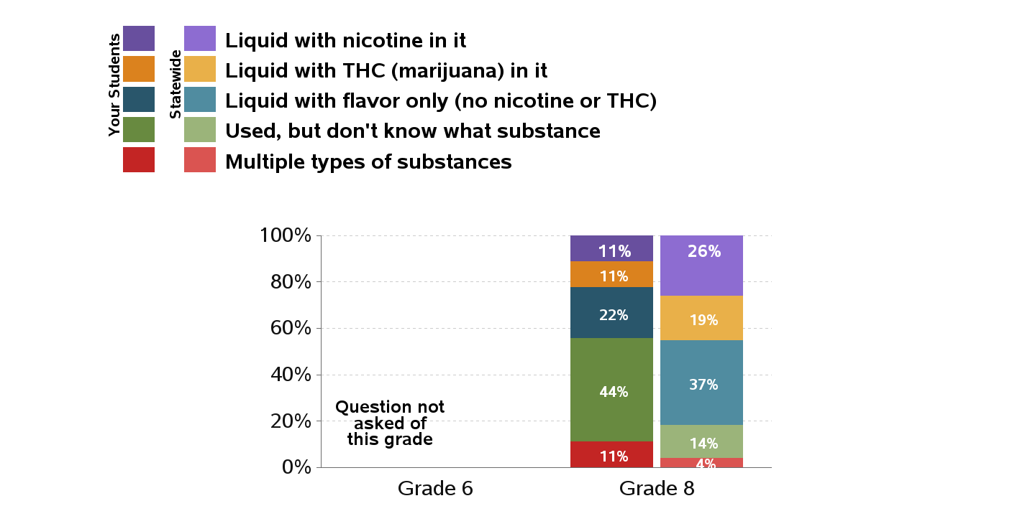
Type of Substance Used in E-Cigarette or Vaped in Past 30 Days
Percentages are of students who used e-cigarettes in the past 30 days

Slide 6
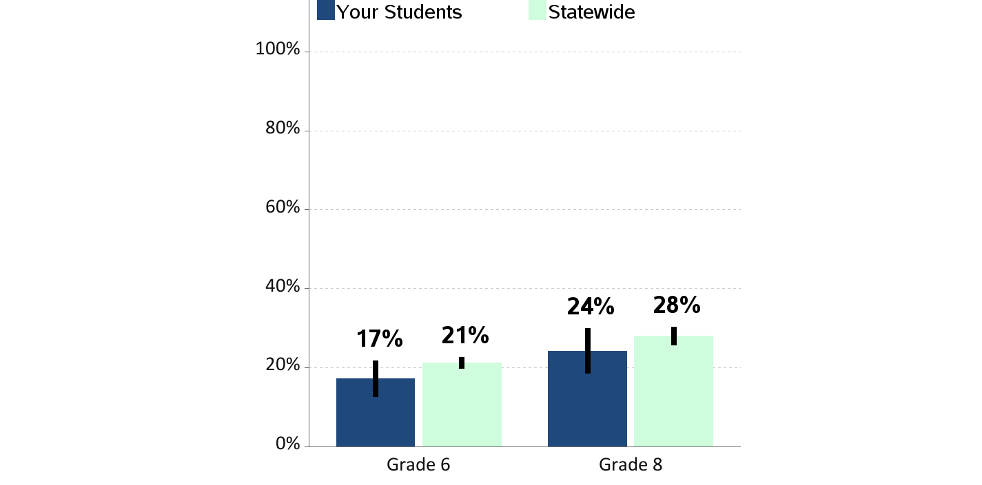
Lifetime Alcohol Use
Percent of students who report having ever drunk
more than a sip of alcohol

Slide 7
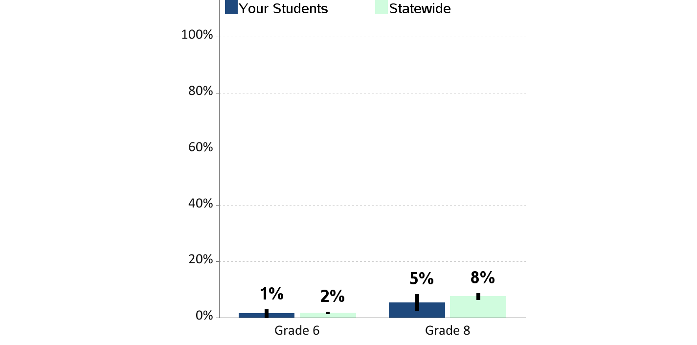
Current Alcohol Use
Percent of students who report having drunk a glass, can or
bottle of alcohol in the past 30 days

Slide 8
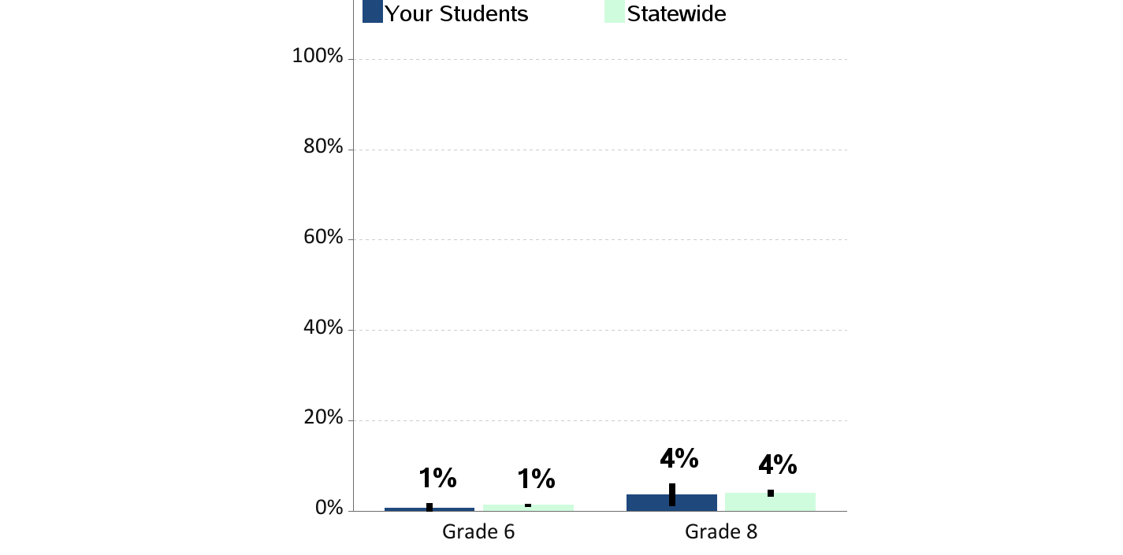
Current Binge Drinking
Percent of students who report having drunk 5 or more drinks
in a row in the past 2 weeks

Slide 9
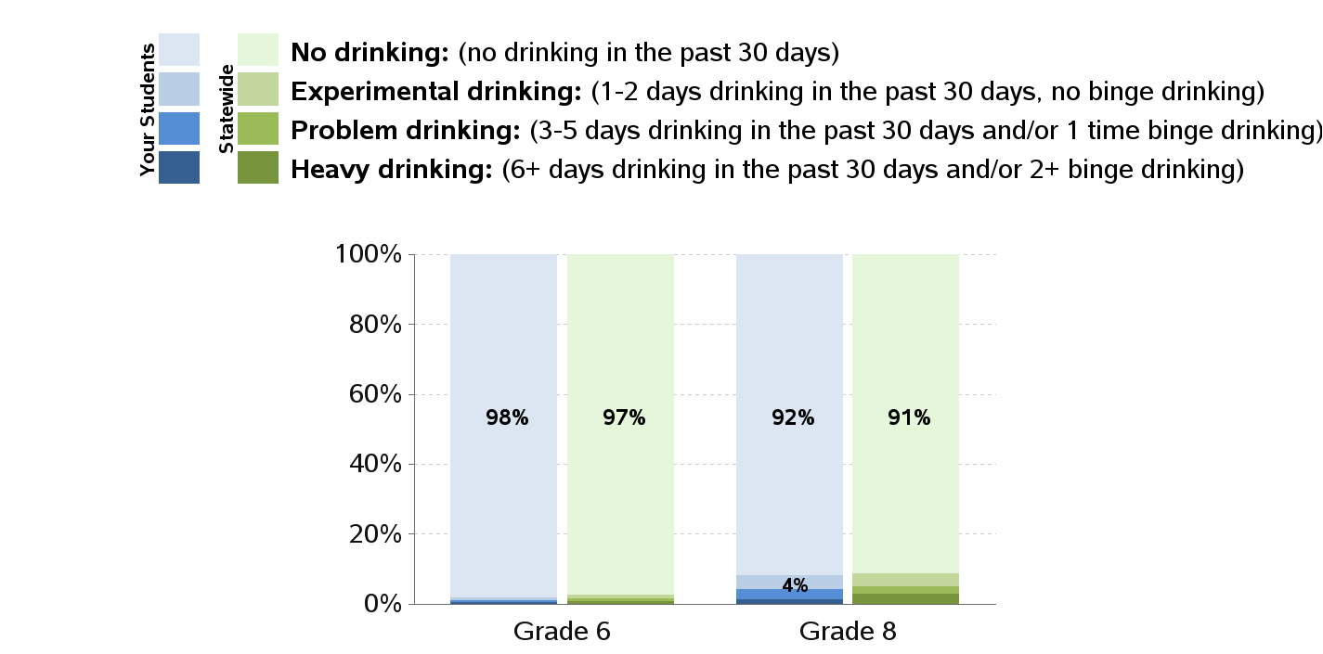
Levels of Alcohol Use

Slide 10
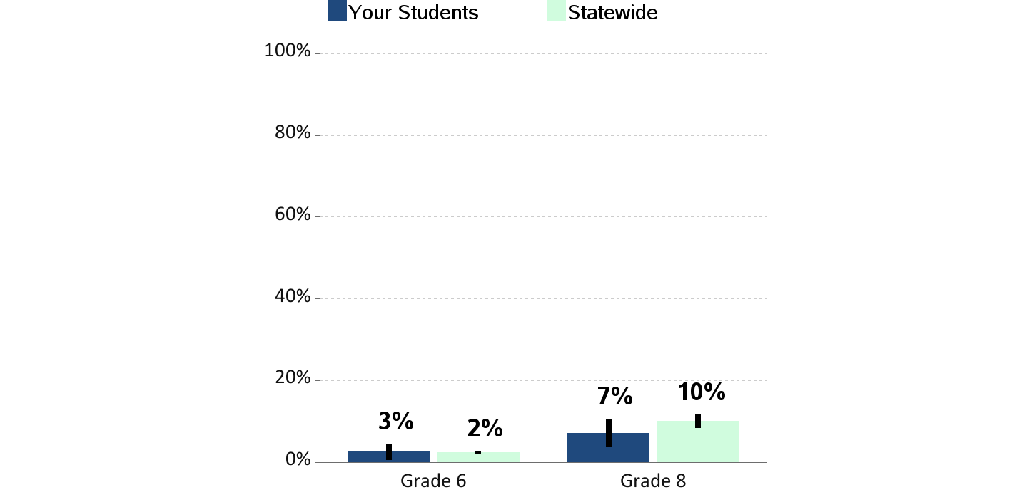
Lifetime Marijuana Use
Percent of students who report having ever used marijuana
|

Slide 11
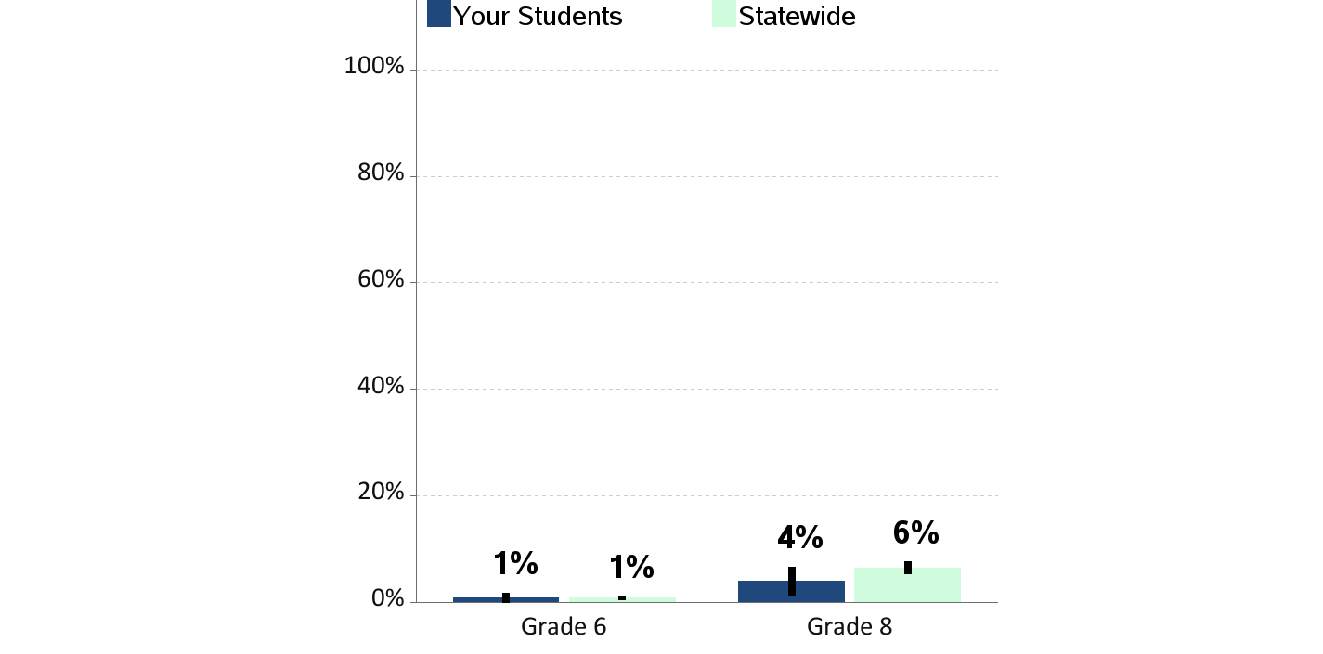
Current Marijuana Use
Percent of students who report using marijuana
in the past 30 days

Slide 12
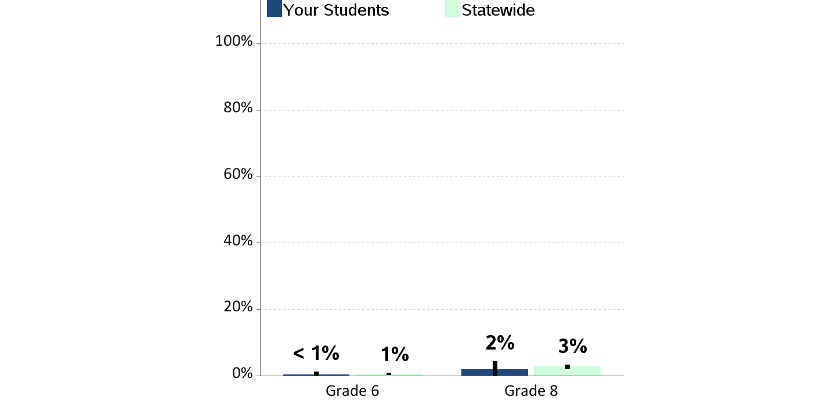
Current Illegal Drug Use
Percent of students who report using illegal drugs
in the past 30 days (not including alcohol, tobacco or marijuana)

Slide 13
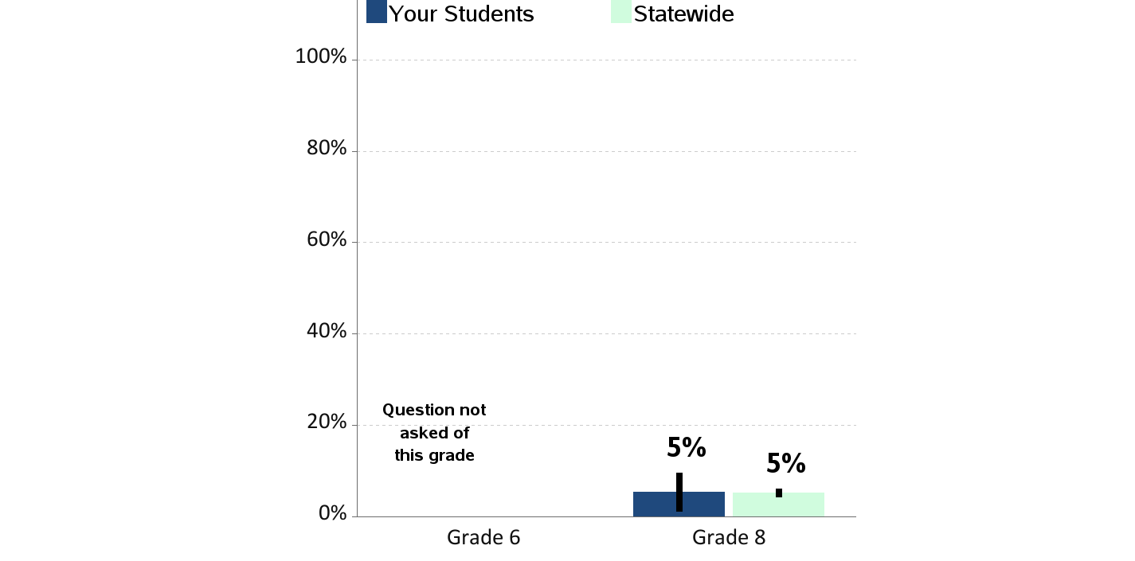
Current Prescription Drug Use
Percent of students who report using prescription drugs
not prescribed to them in the past 30 days

Slide 14
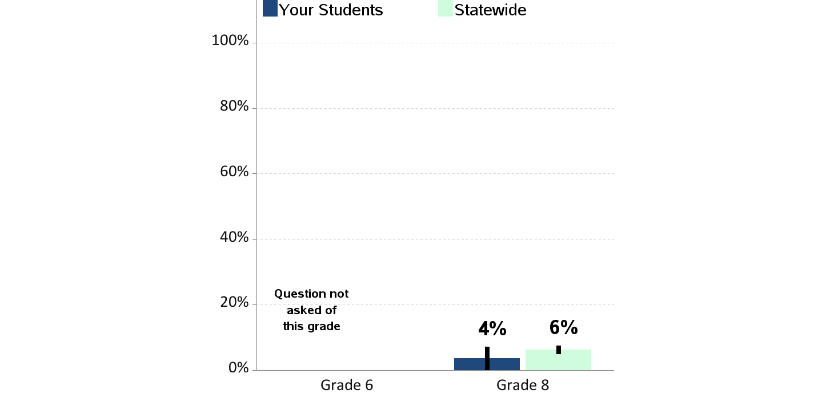
Substance Use at School
Percent of students who report being drunk or high at school
in the past year

Slide 15

Alcohol Use on School Property
Percent of students who report having at least one drink of alcohol
on school property in the past 30 days

Slide 16

Marijuana Use on School Property
Percent of students who report using marijuana
on school property in the past 30 days

Slide 17

E-Cigarette Use on School Property
Percent of students who report using an electronic cigarette
on school property in the past 30 days

Slide 18
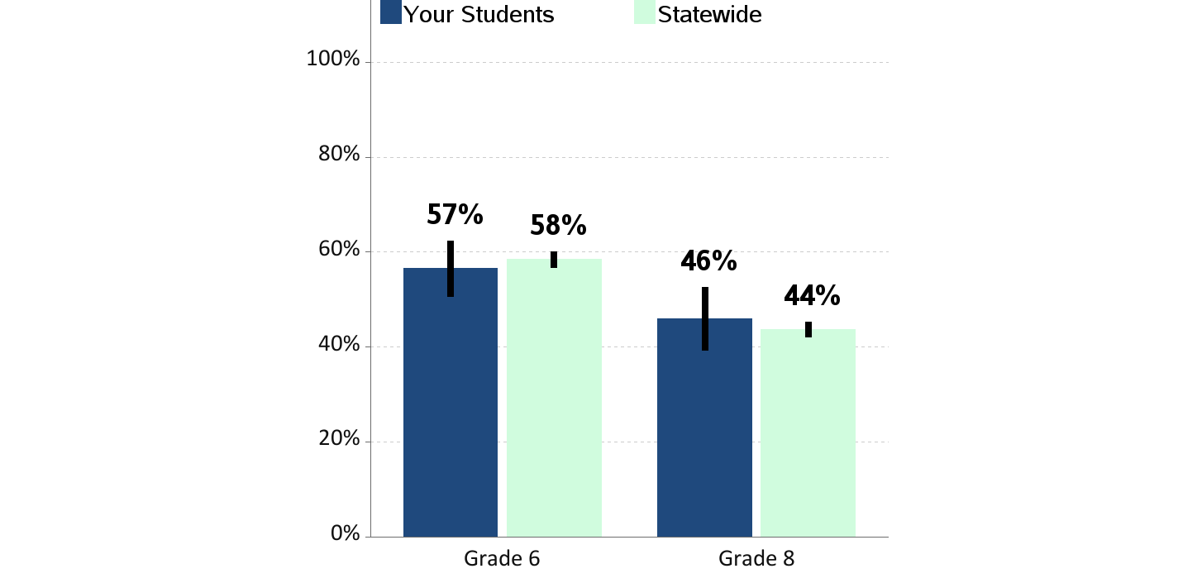
Enjoyment of School
Percent of students who report "often" or "almost always" enjoying
being at school in the past year

Slide 19
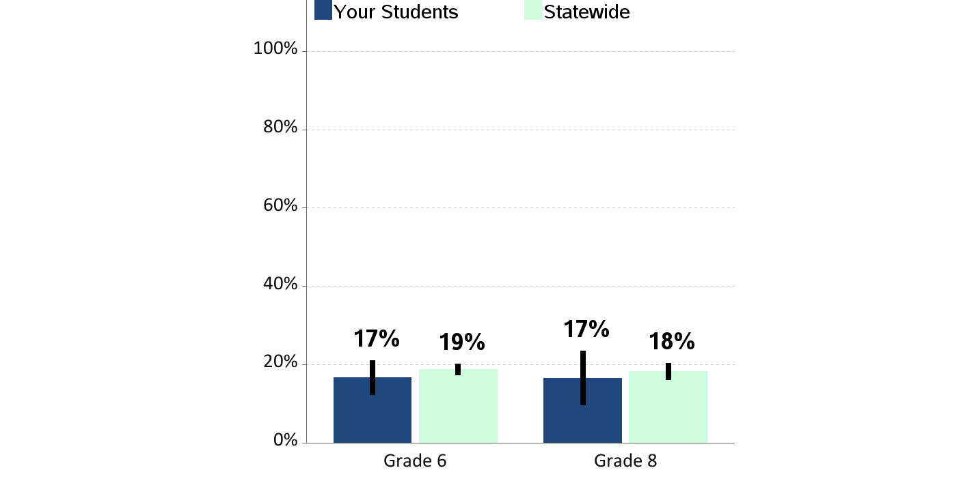
Skipping School
Percent of students who report skipping
1 or more whole days of school in the past 4 weeks

Slide 20
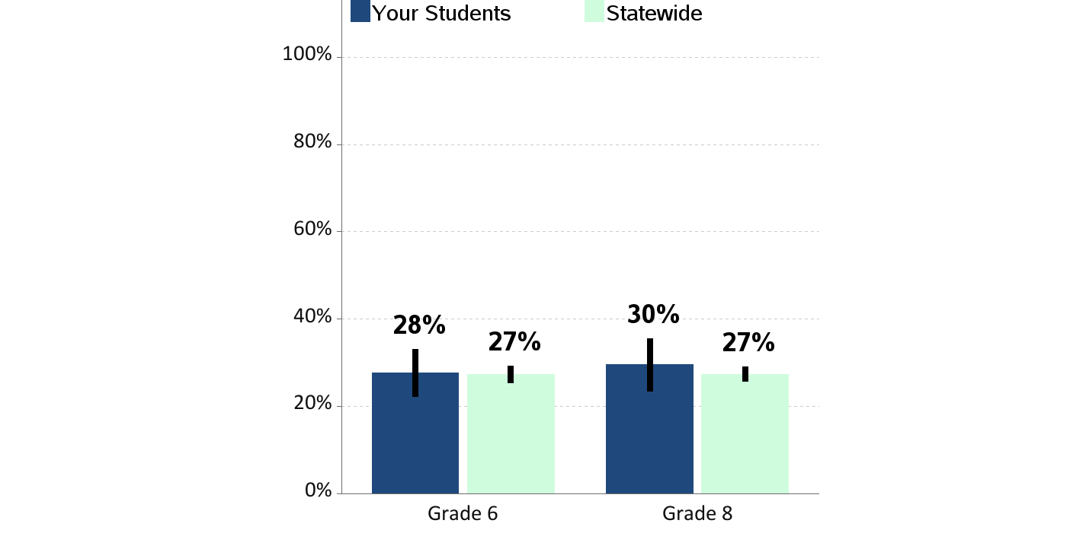
Bullying
Percent of students who report being bullied
in the past 30 days

Slide 21
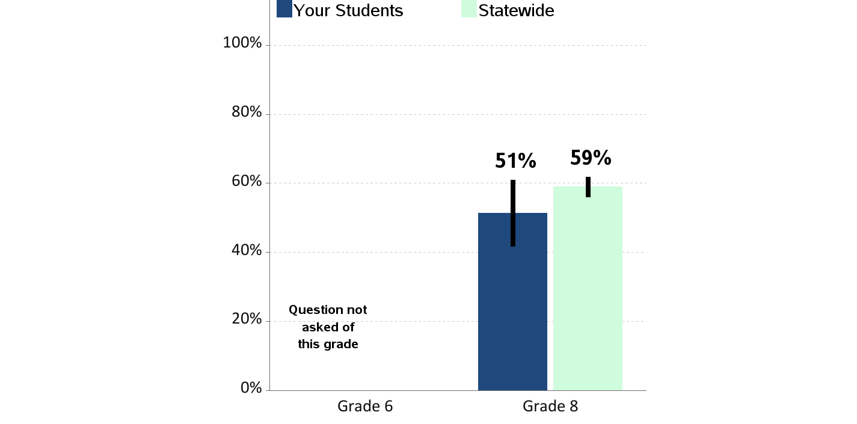
School Tries to Stop Bullying
Percent of students who report teachers or other adults at school
“almost always” or “often” try to stop bullying

Slide 22
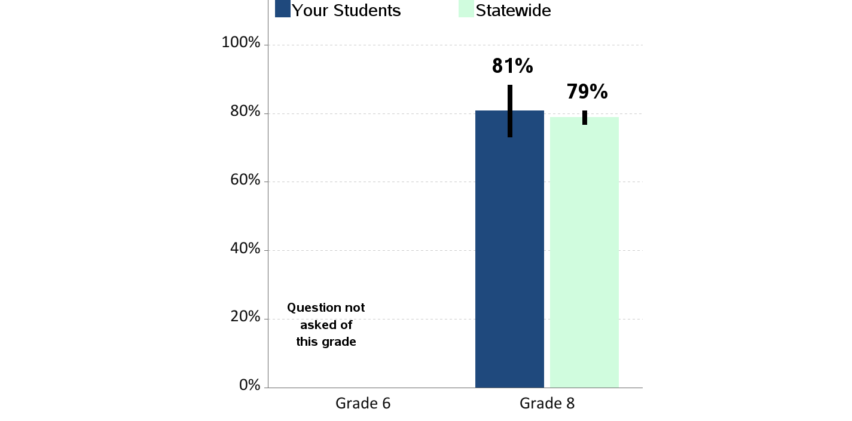
Students Know How to Report Bullying
Percent of students who report they know how to report bullying at school
|

Slide 23
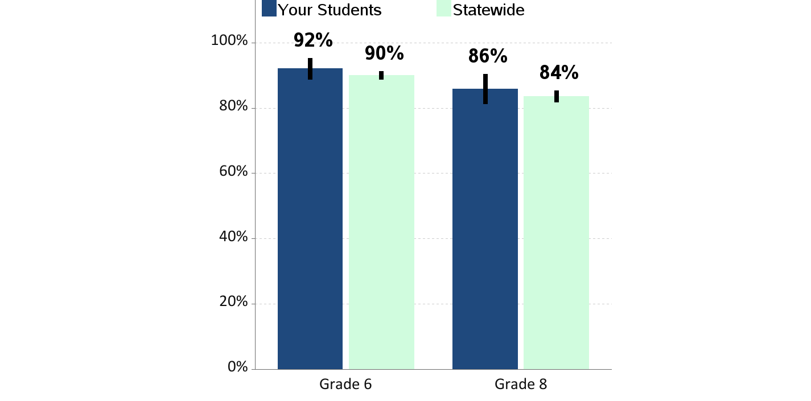
Feeling Safe at School
Percent of students who report that they feel safe at school
|

Slide 24
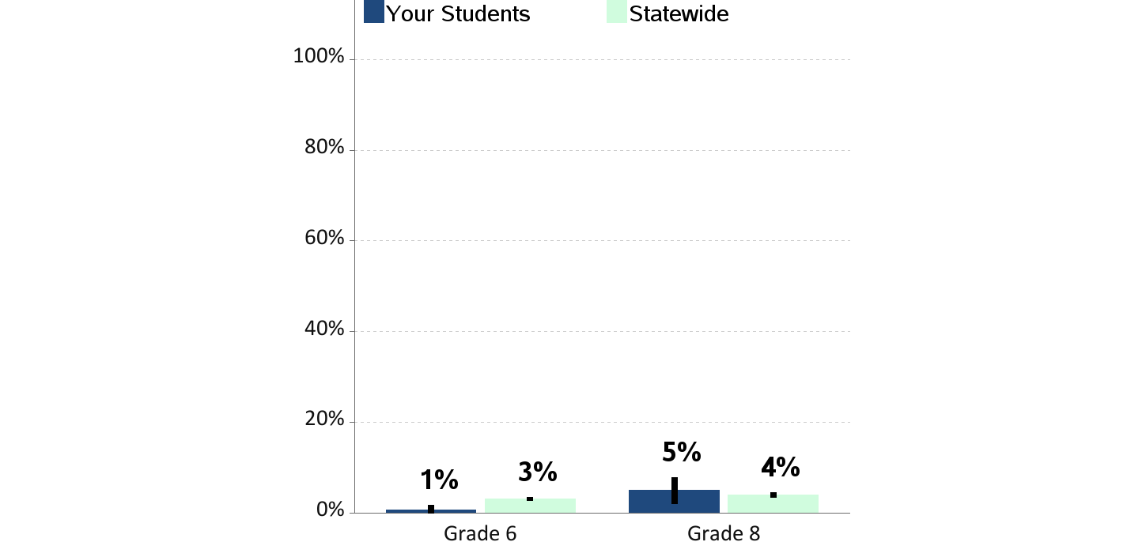
Weapon Carrying at School
Percent of students who report carrying a weapon on school property
in the past 30 days

Slide 25
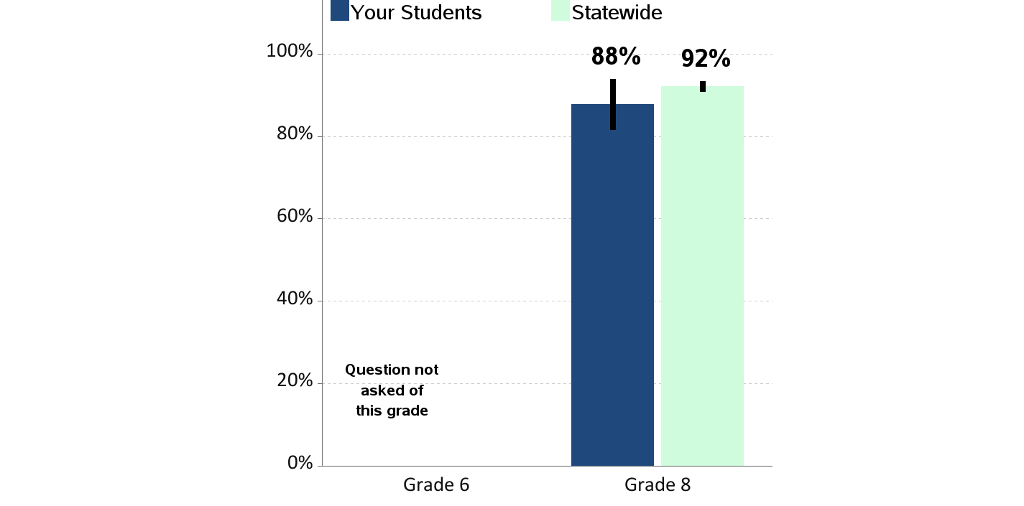
Opportunities for School Involvement
Percent of students who report that they have lots of chances
for involvement in school activities

Slide 26
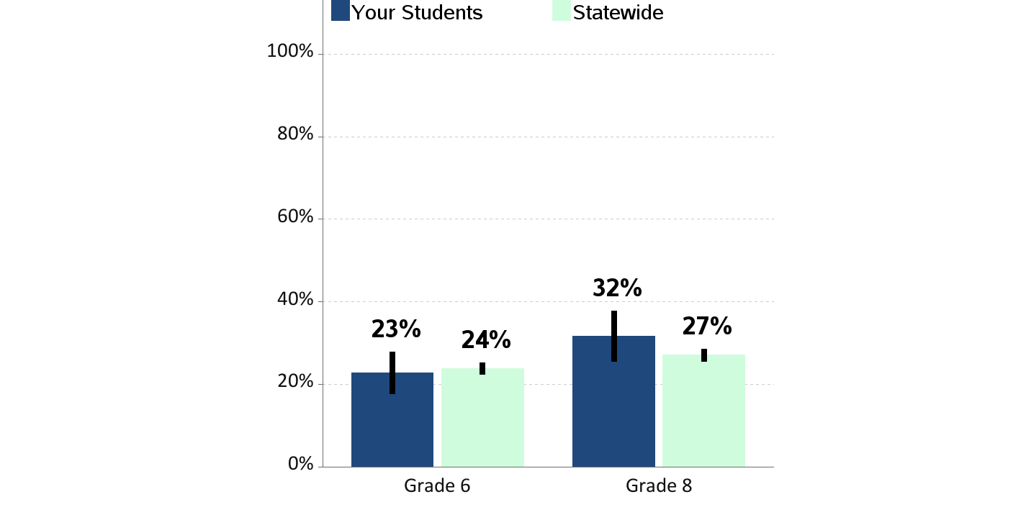
Physical Fighting
Percent of students who report being in a physical fight
in the past year

Slide 27
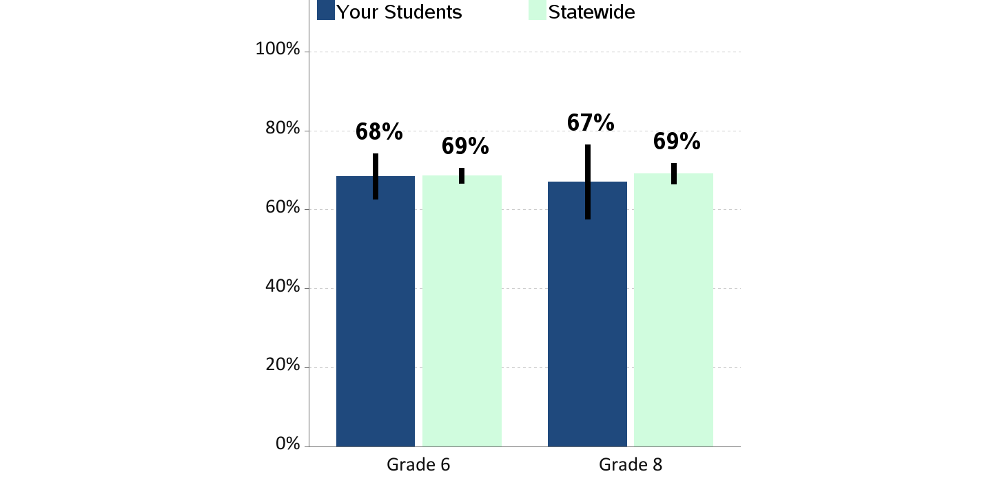
Social Emotional Skills
Percent of students who know how to handle disagreements, solve problems,
consider effects of decisions, and be empathetic

Slide 28
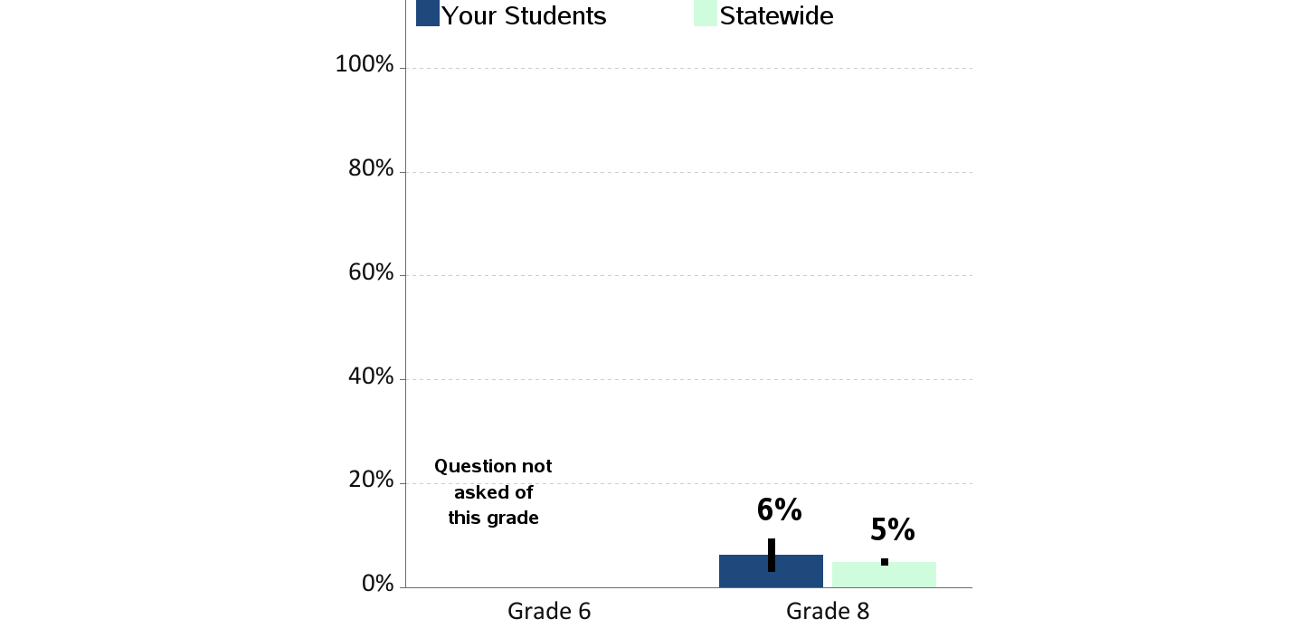
Gang Membership
Percent of students who report being members of a gang
in the past year

Slide 29
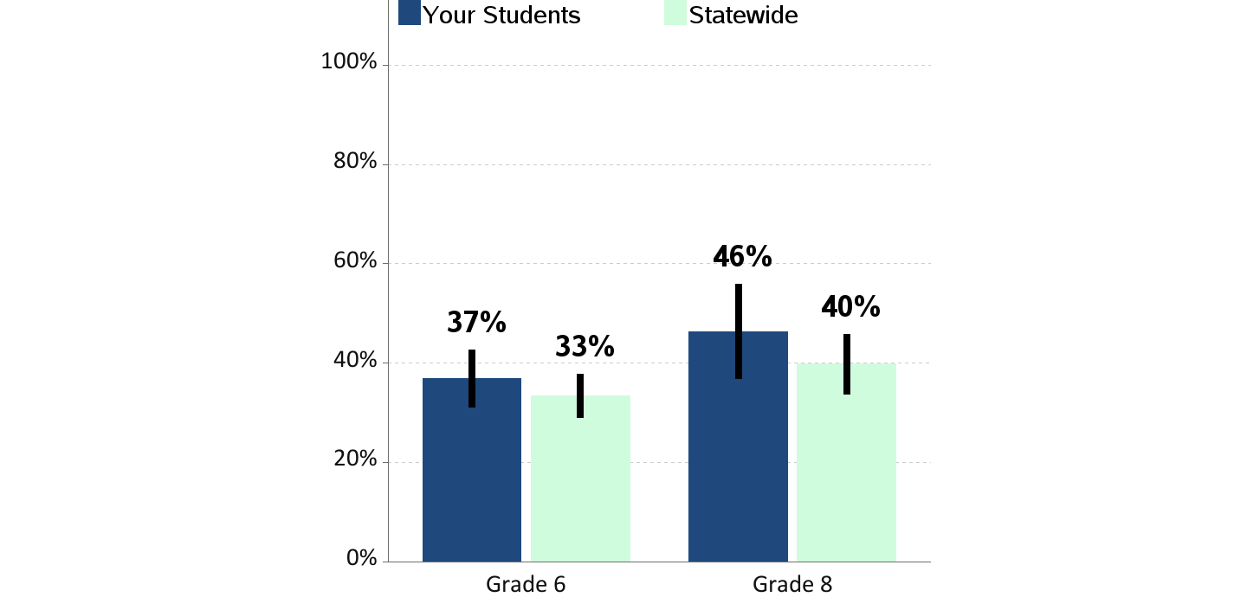
Walking/Biking To or From School
Percent of students who report walking or riding a bicycle
to or from school during an average week

Slide 30
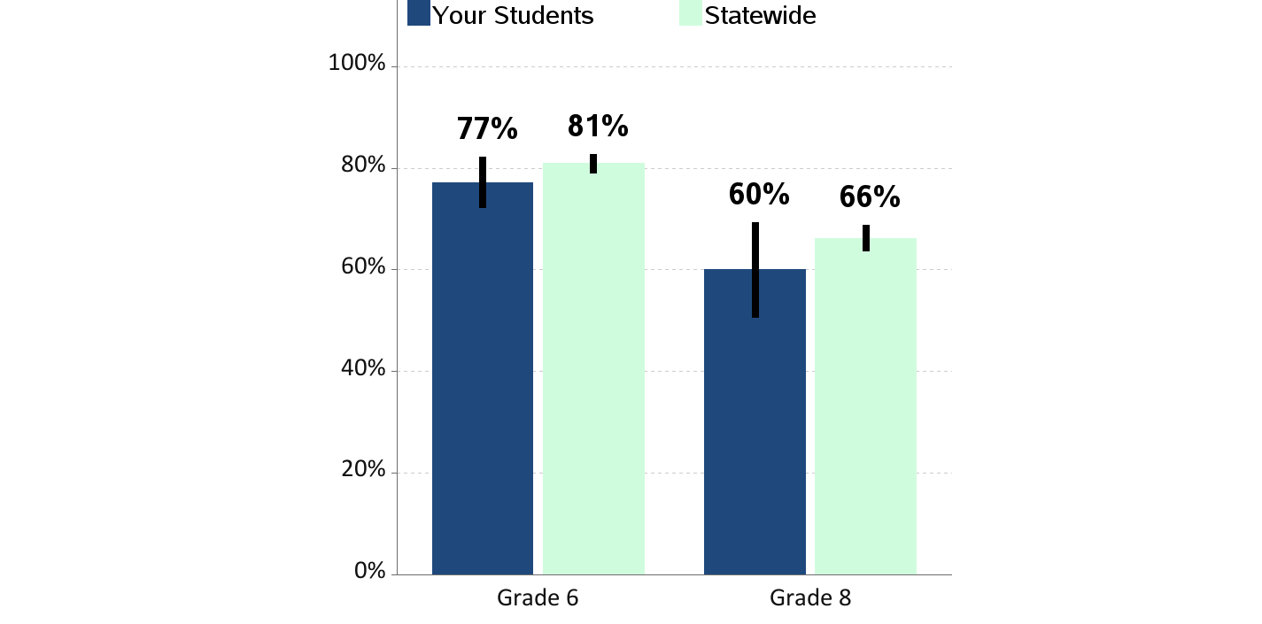
Eating Breakfast
Percent of students who report eating breakfast today
|

Slide 31
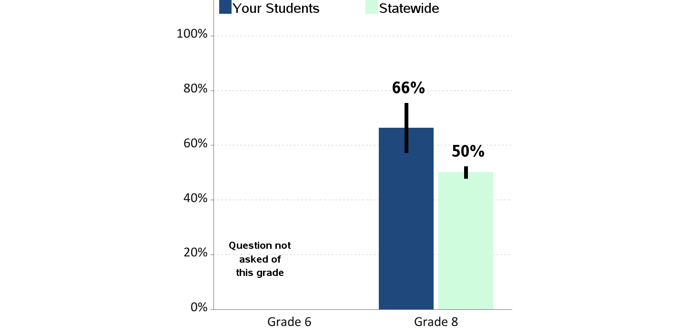
Sleep on a School Night
Percent of students who report sleeping less than 8 hours
on an average school night

Slide 32
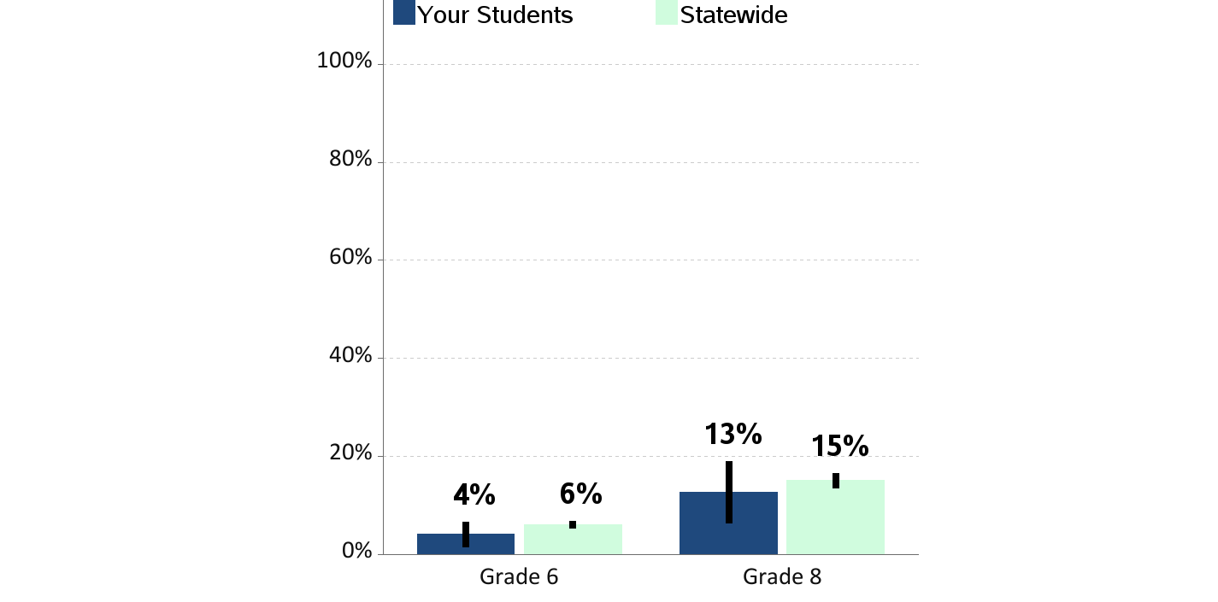
Riding with a Drinking Driver
Percent of students who report having ridden in the past 30 days
with a driver who had been drinking alcohol

Slide 33
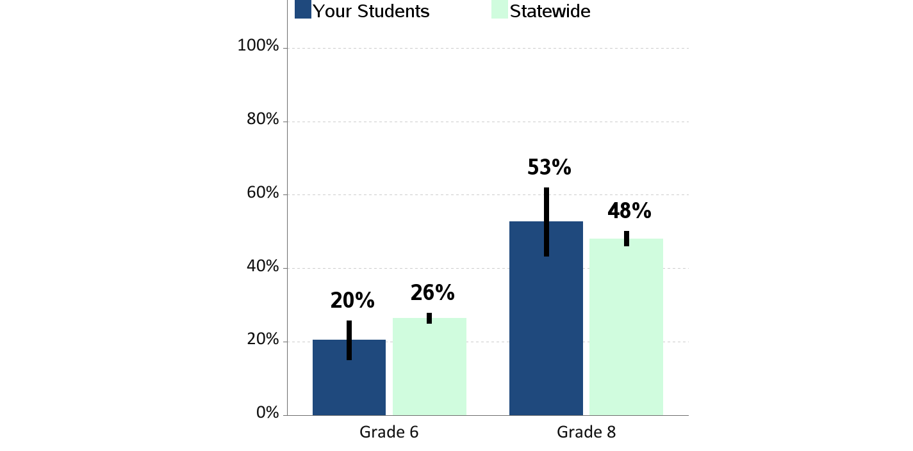
Riding With a Texting Driver
Percent of students who report having ridden in the past 30 days
with a driver who was texting or emailing

Slide 34
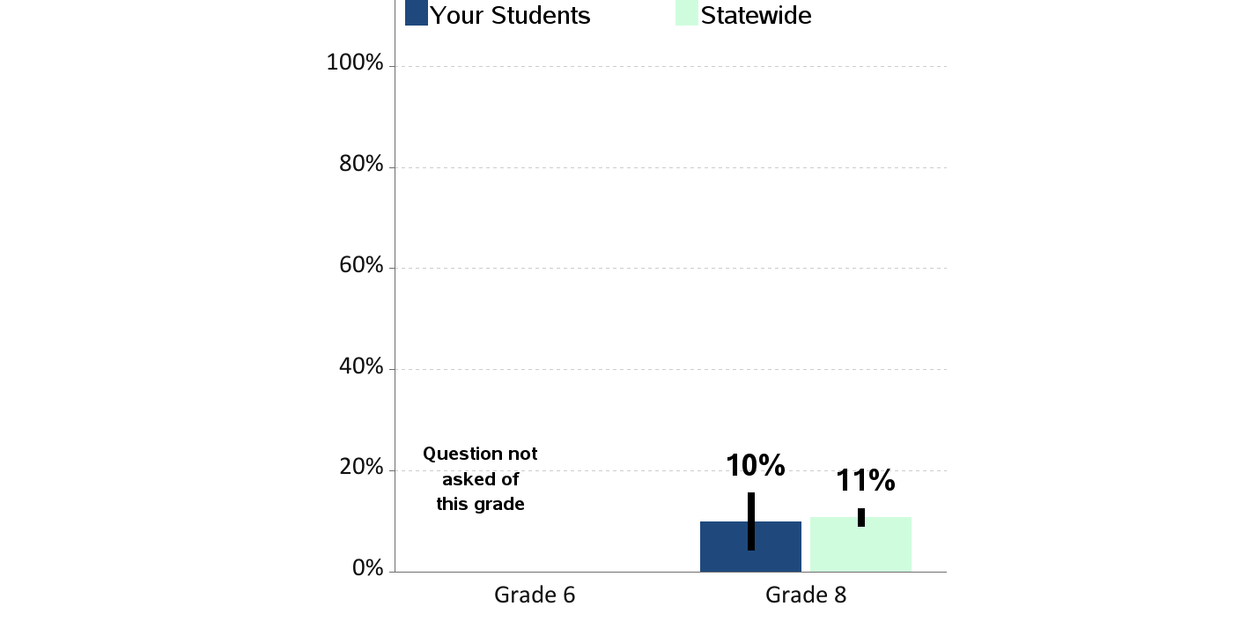
Riding With a Recent Marijuana User
Percent of students who report having ridden in the past 30 days
with a driver who had been using marijuana

Slide 35
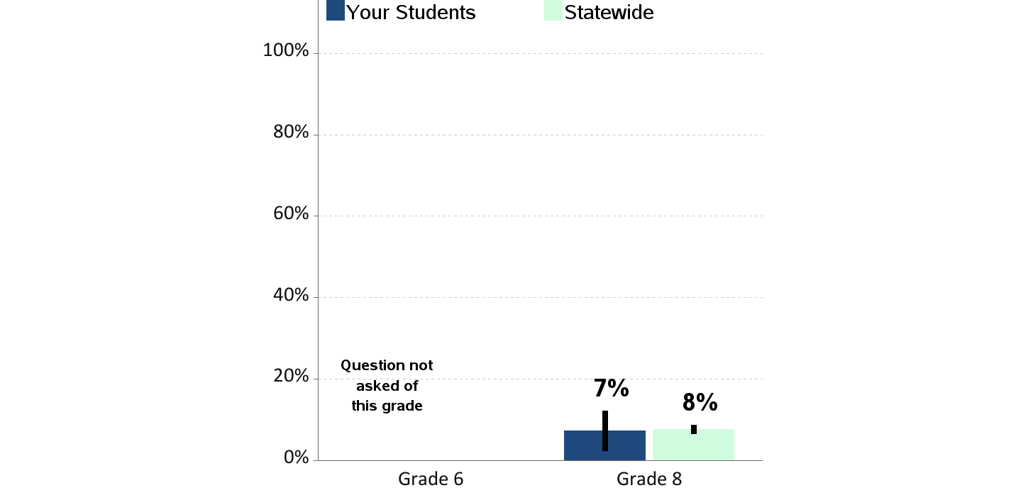
Excessive Sugar Sweetened Beverages Consumption
Percent of students who report drinking sugar sweetened beverages 2 or more times a day
|

Slide 36
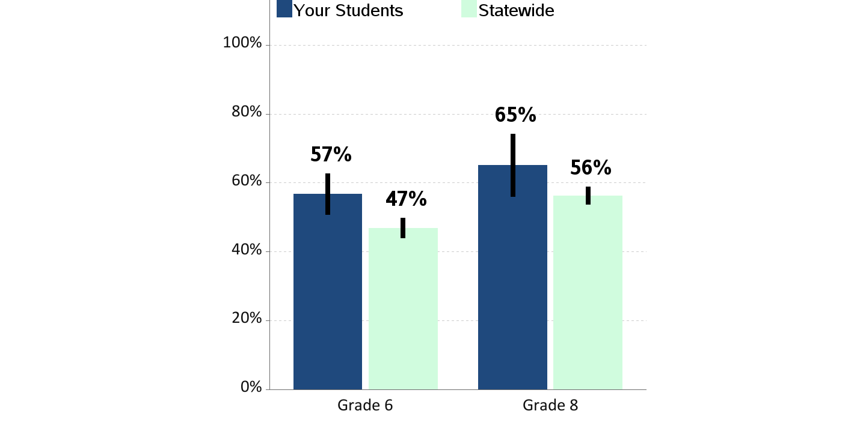
Excessive Television/Video Game Use
Percent of students who report 3 or more hours watching television,
playing video games or using the computer for fun on an average school day

Slide 37
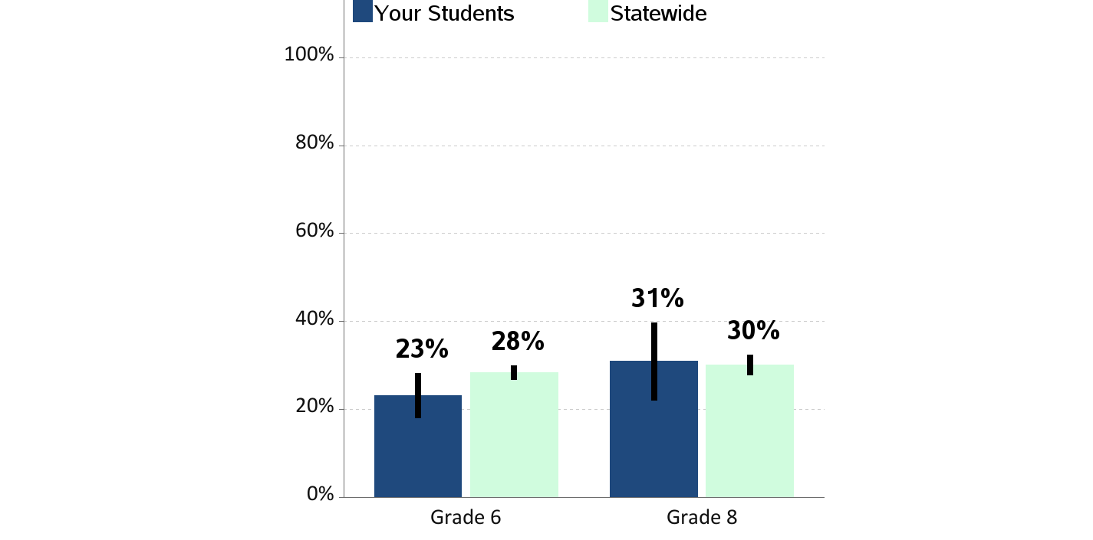
60 Minutes of Physical Activity per Day
Percent of students who report being physically active
60 minutes per day, 7 days a week

Slide 38
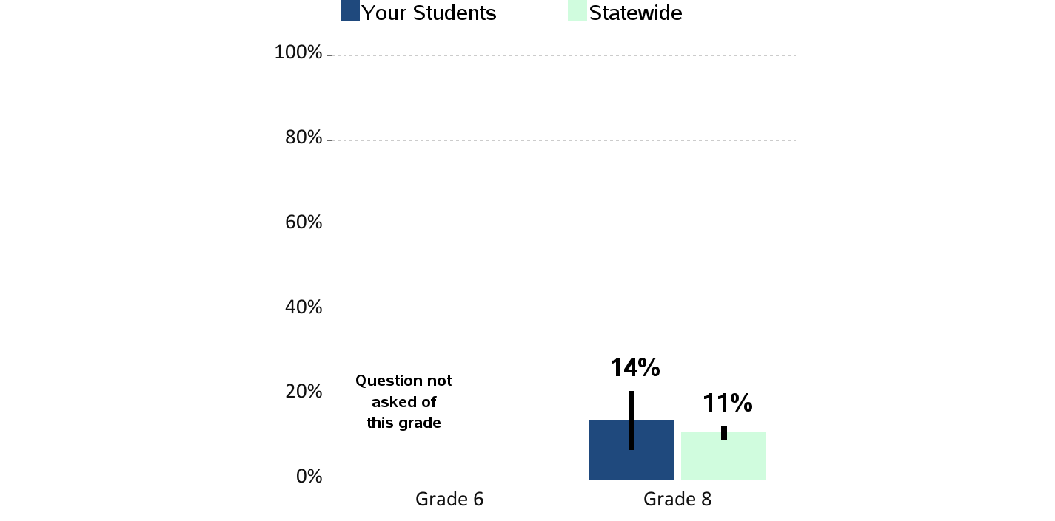
Obesity
Percent of students who are obese
(according to reported height and weight)

Slide 39
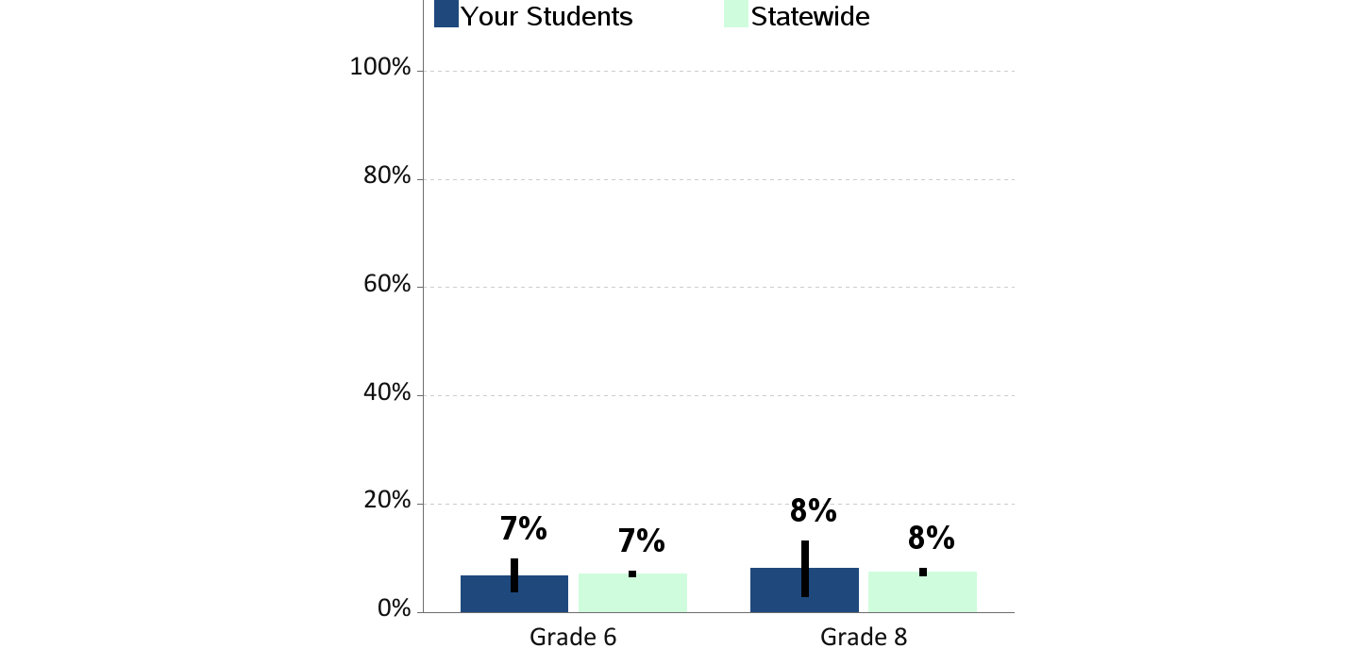
Current Asthma
Percent of students who currently have asthma
|

Slide 40
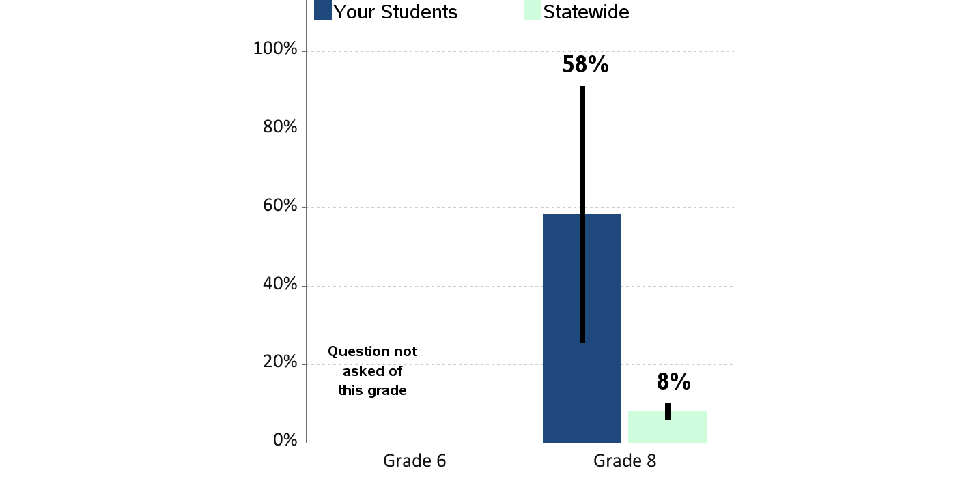
Lifetime Sexual Activity
Percent of students who report ever having sexual intercourse
in their lifetime

Slide 41
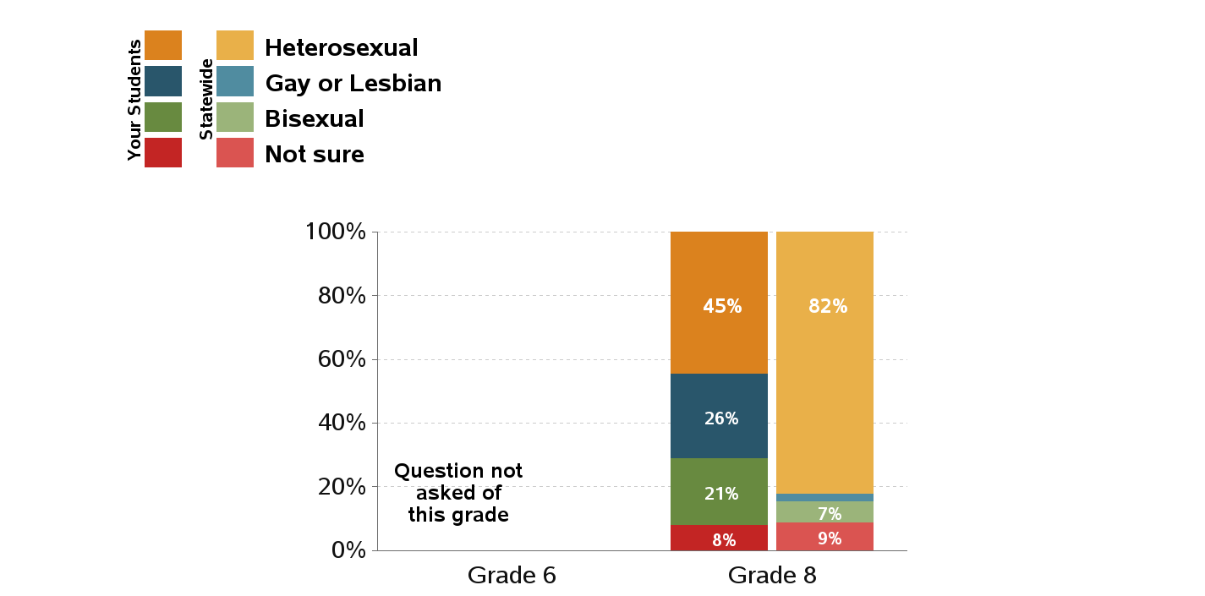
Sexual Orientation

Slide 42
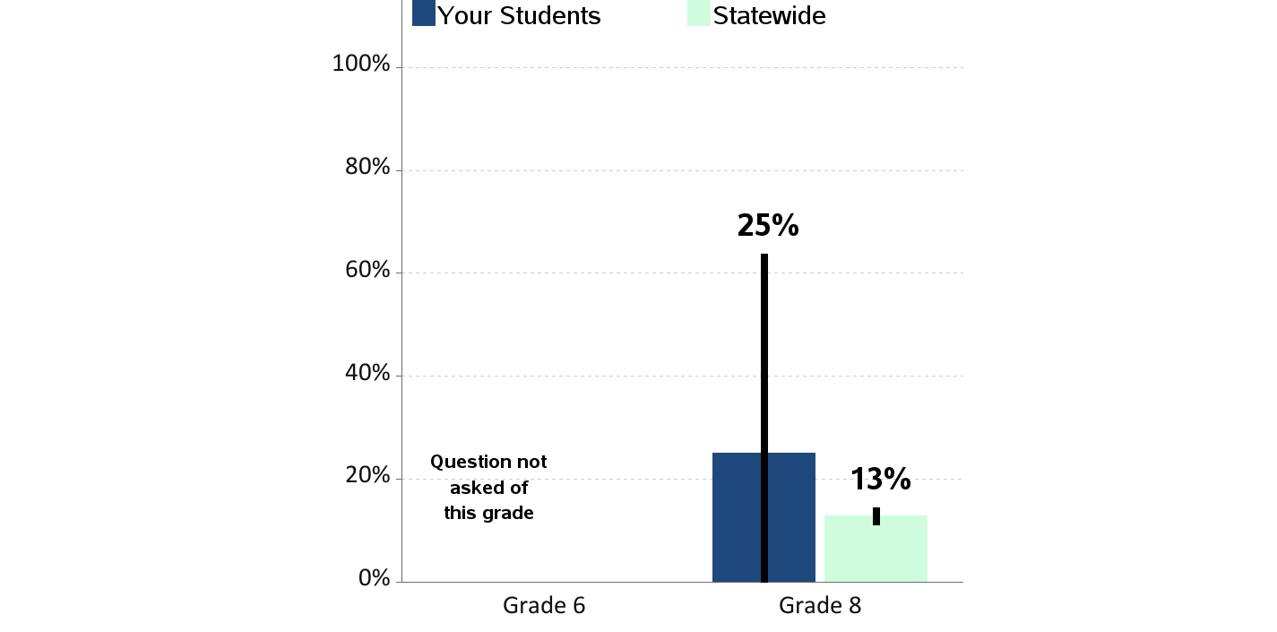
Lifetime Sexual Abuse
Percent of students who report having ever been in a in a situation where someone
made them engage in kissing, sexual touch or sexual intercourse when they did not want to

Slide 43
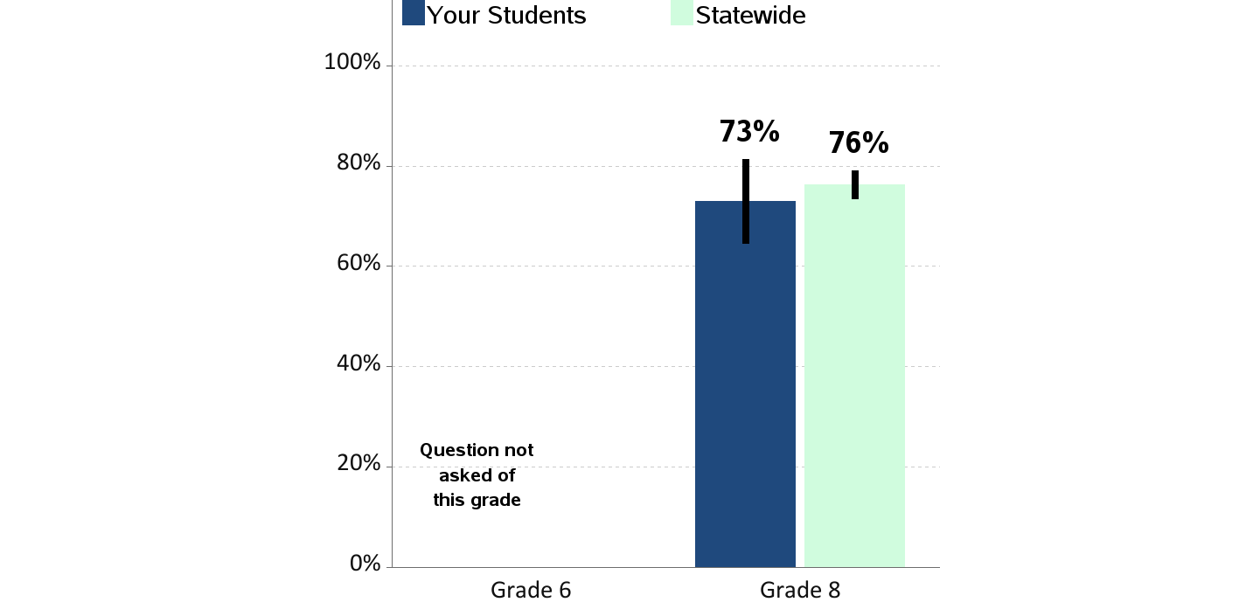
Access to Dental Care
Percent of students who report visiting a dentist for a routine checkup
in the past year

Slide 44
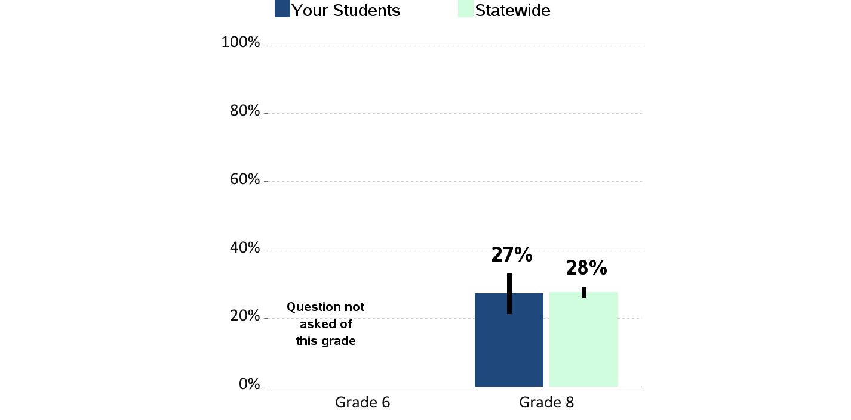
Depression
Percent of students who report experiencing depressive feelings
in the past year

Slide 45
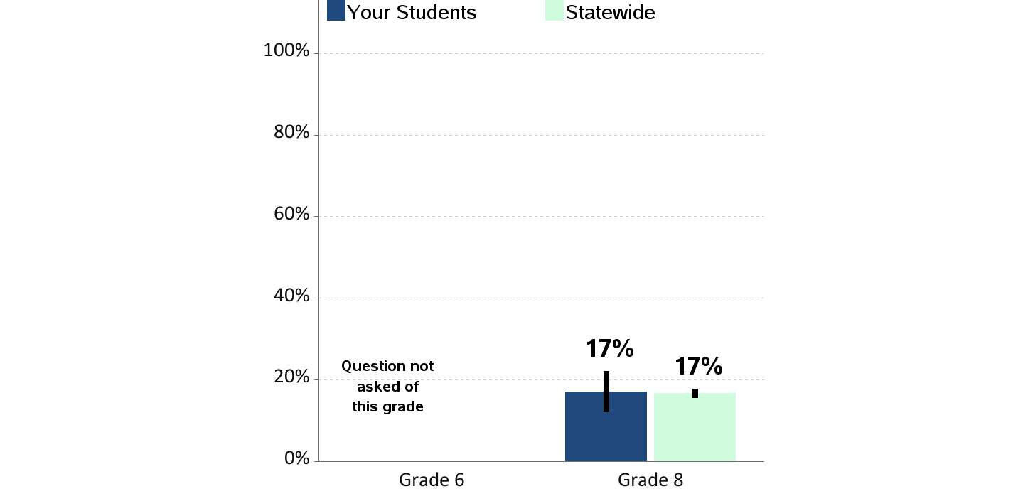
Contemplation of Suicide
Percent of students who report having seriously considered suicide
in the past year

Slide 46
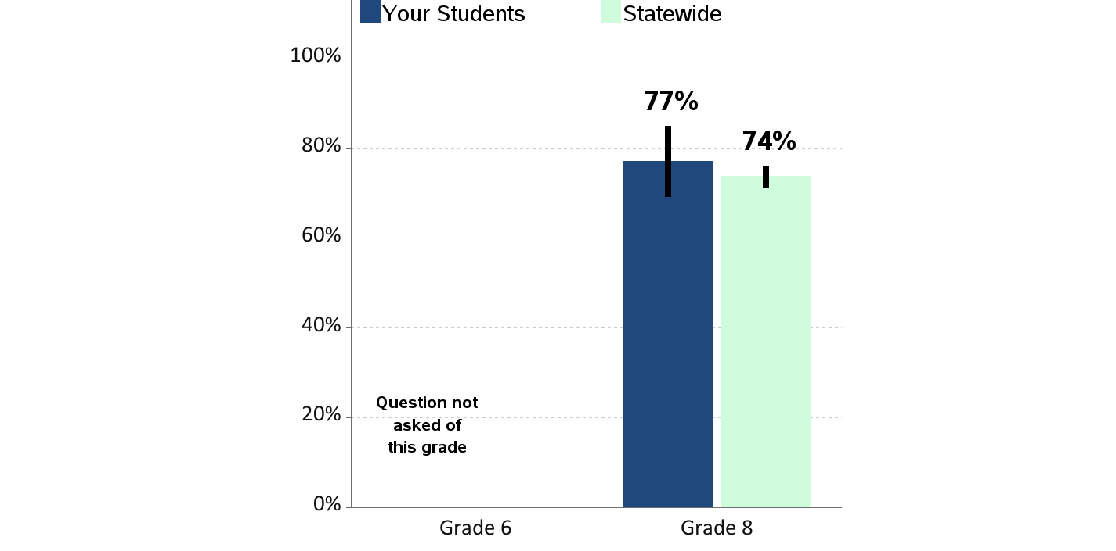
Someone in Community to Talk To
Percent of students who report having an adult in their neighborhood or community
they can talk to about something important

Slide 47
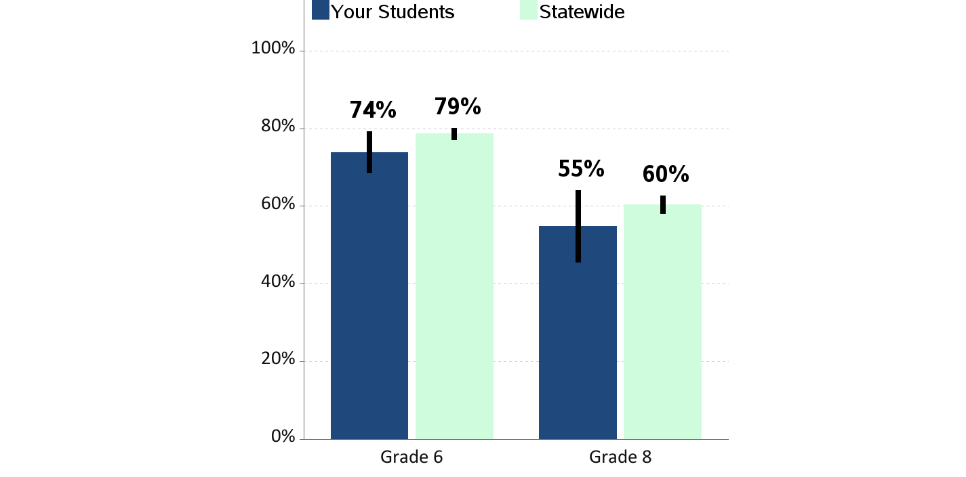
Perception of Neighborhood Norms - Alcohol
Percent of students who report that adults in their neighborhood
think youth drinking is "very wrong"

Slide 48
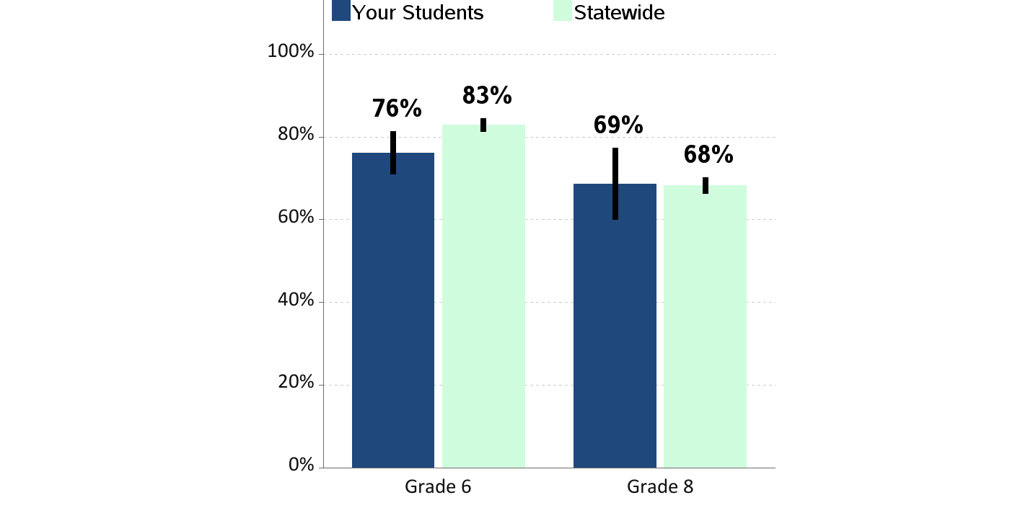
Perception of Neighborhood Norms - Smoking
Percent of students who report that adults in their neighborhood
think youth smoking is "very wrong"

Slide 49
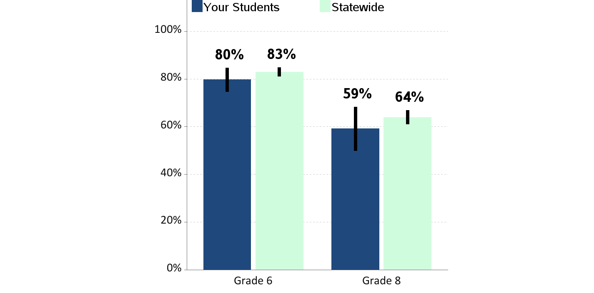
Perception of Neighborhood Norms - Marijuana
Percent of students who report that adults in their neighborhood
think youth marijuana use is "very wrong"

Slide 50
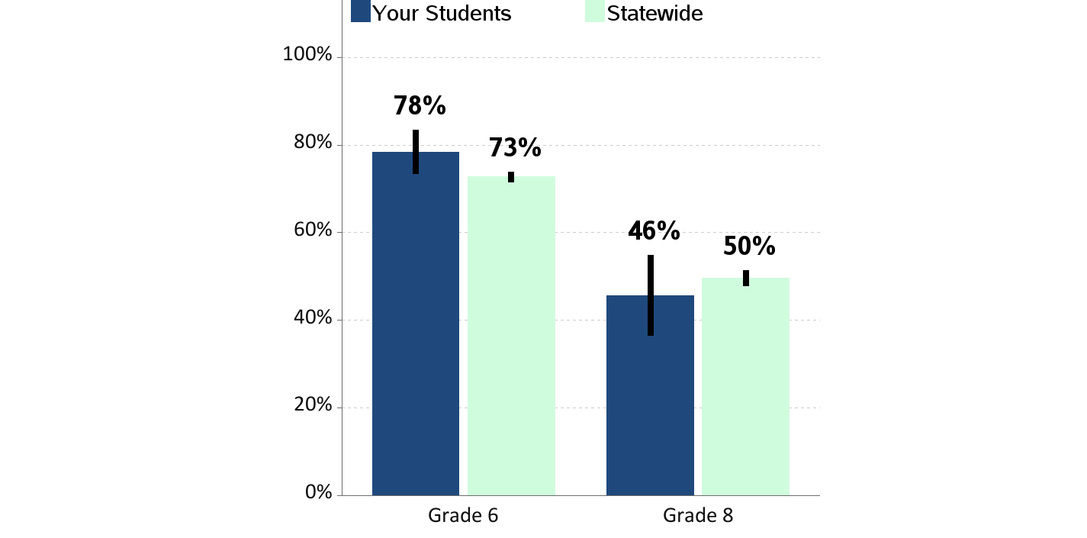
Perceived Availability of Alcohol
Percent of students who report alcohol
would be "very hard" to get

Slide 51
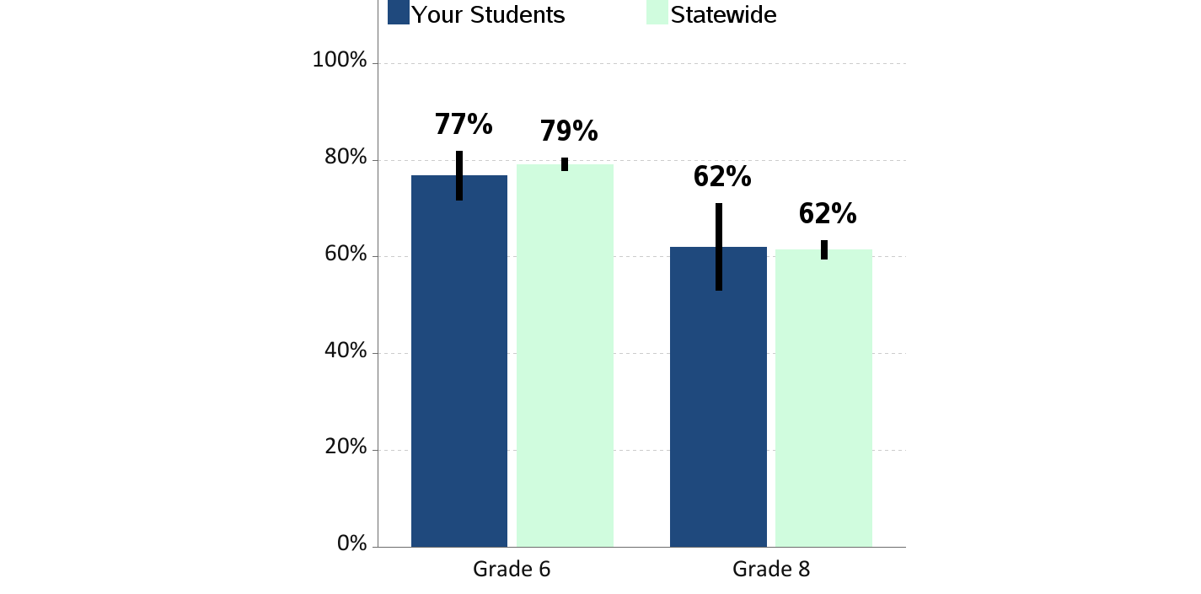
Perceived Availability of Cigarettes
Percent of students who report cigarettes
would be "very hard" to get

Slide 52
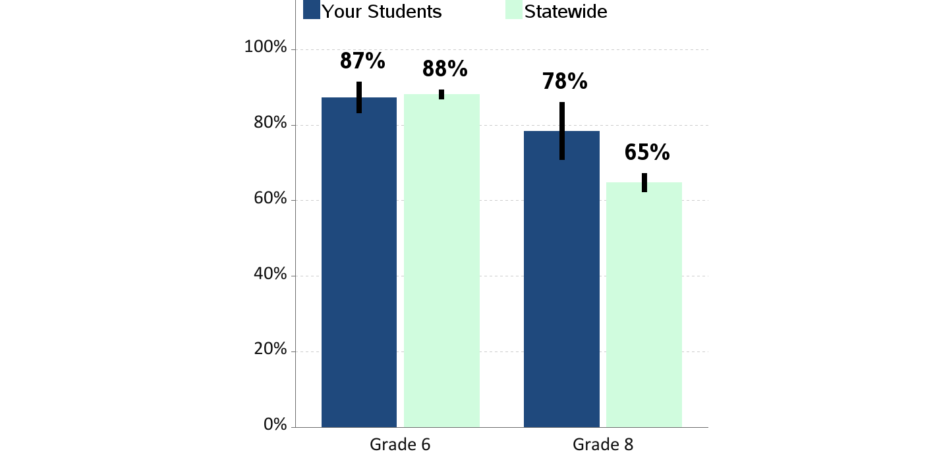
Perceived Availability of Marijuana
Percent of students who report marijuana
would be "very hard" to get

Slide 53
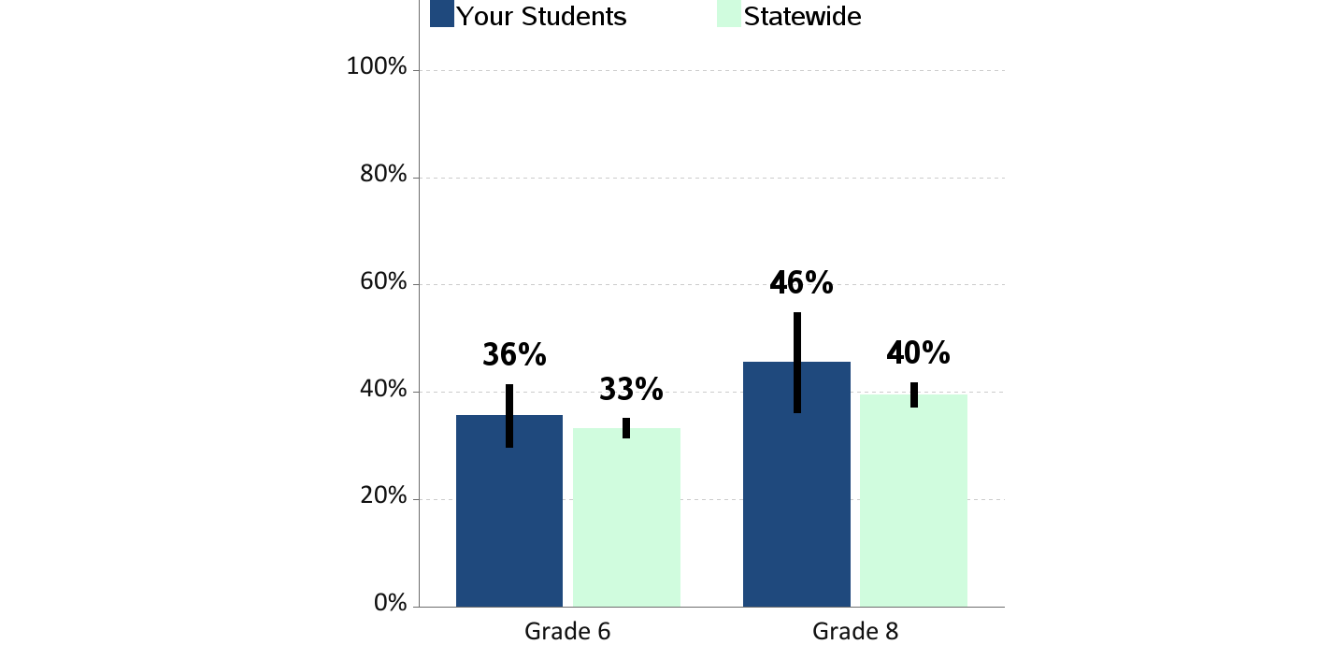
Perceived Risk of Regular Alcohol Use
Percent of students who report "great risk" of harm
from drinking alcohol daily

Slide 54
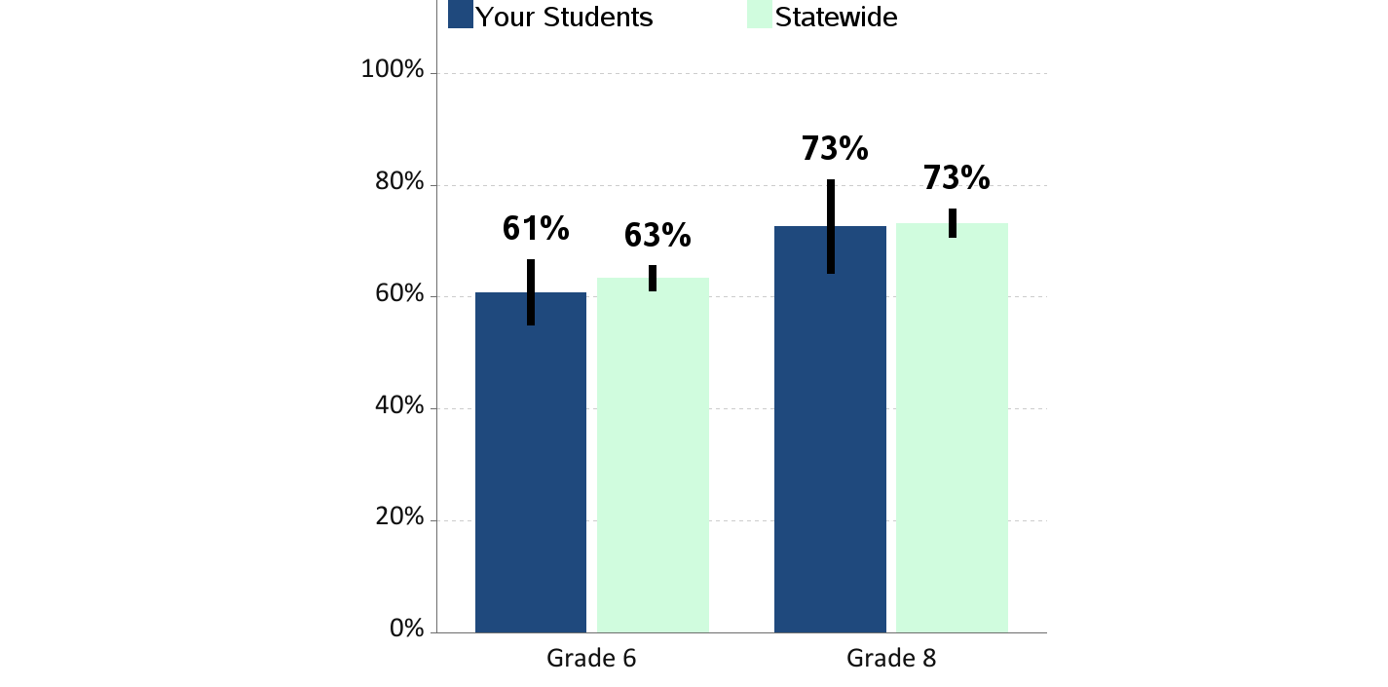
Perceived Risk of Regular Cigarette Smoking
Percent of students who report "great risk" of harm
from smoking a pack or more a day

Slide 55
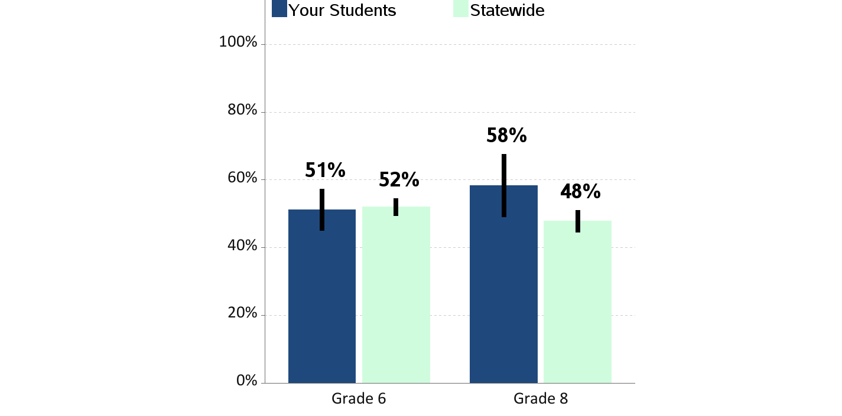
Perceived Risk of Regular Marijuana Use
Percent of students who report "great risk" of harm
from using marijuana at least once or twice a week

Slide 56

Perceived Risk of E-Cigarette Smoking or Vaping
Percent of students who report "great risk" of harm from
using e-cigarette or vape pen regularly (almost daily)

